Slide 1
Family violence crisis response model
Information sessions November 2022

Slide 2
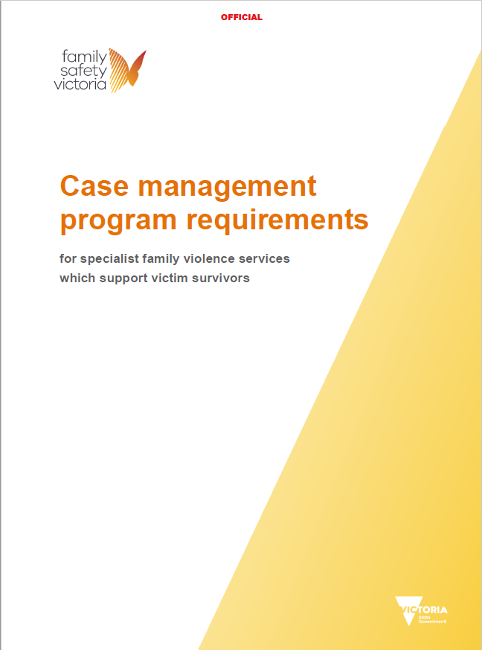
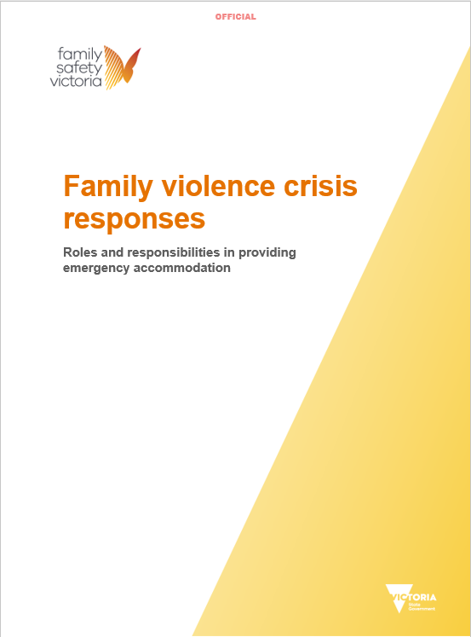
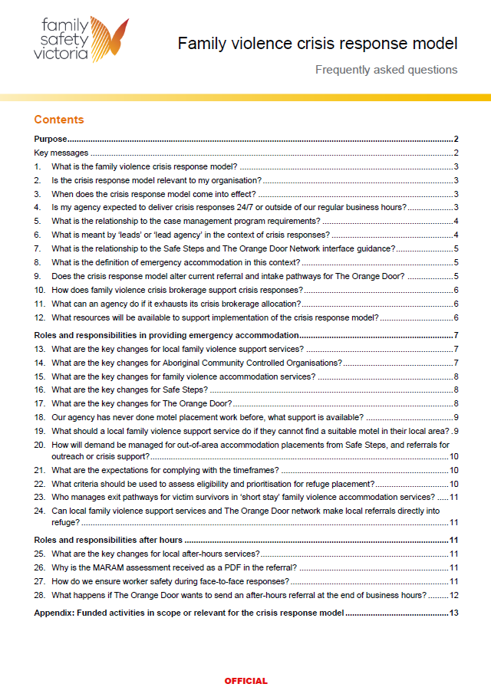
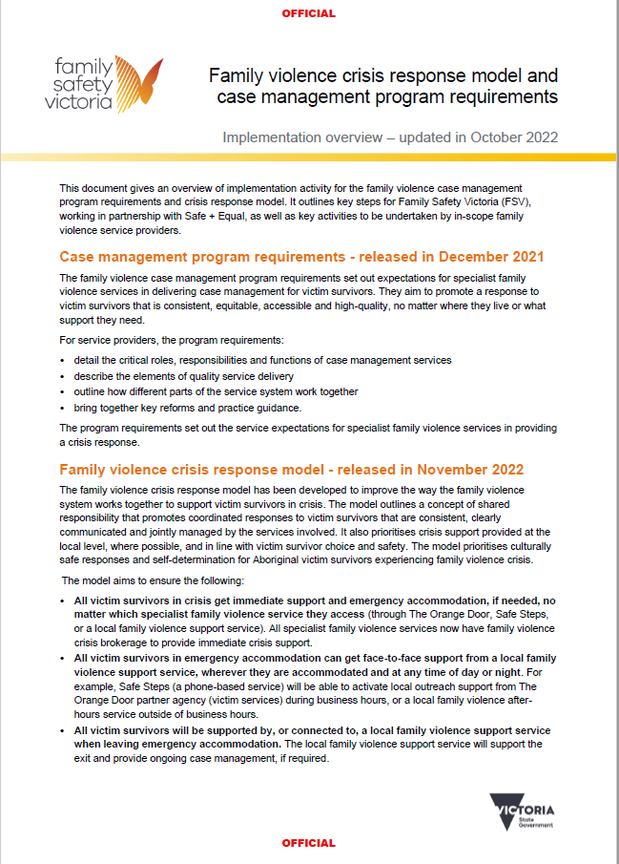
Today’s information session – key documents
Released Dec 2021
Released Nov 2022
1
2
3
4
5

Slide 3
Family violence crisis response model – introduction
Existing family violence crisis responses vary across the state.
For victim survivors: uncertainty, multiple relocations/handovers, undermines trust and confidence in system, inequitable access to support
For services: confusion, inefficiencies, service coordination challenges
Since 2019, Family Safety Victoria (FSV) has been working in partnership with Safe and Equal, sector representatives, Aboriginal community-controlled organisations and victim survivors to develop the Family violence crisis response model.
The model has been designed to improve the way the family violence service system works together to support victim survivors in crisis. This has included a focus on crisis responses needing emergency accommodation and crisis responses delivered after hours.
The model aims to ensure the following:
All victim survivors in crisis get immediate support and emergency accommodation, if needed, no matter which specialist family violence service they access.
All victim survivors in emergency accommodation can get face-to-face support from a local family violence support service, wherever they are accommodated and at any time of day or night.
All victim survivors will be supported by, or connected to, a local family violence support service when leaving emergency accommodation.
The model prioritises victim survivor choice and agency.
The model also aims to improve service coordination and create system efficiencies that lead to enhanced support for victim survivors in crisis.
The model is underpinned by a commitment to Aboriginal self-determination – it has been designed to ensure Aboriginal victim survivors have the choice of Aboriginal-led support, and that all responses are culturally safe regardless of where they access support.

Slide 4
Family violence crisis response model – reform context
New family violence crisis response model
Release and preparation
November 2022 to March 2023
Implementation and alignment
From 1 April 2023
Co-design and consultation on FV Case Management Program Requirements, FV Crisis Response Model, Key System Enablers and associated FV Funding Reform
Crisis response roles & responsibilities for
Safe Steps, TOD, local FV support services (inc. after hours, ACCOs and targeted services) and refuges
Victorian family violence refuge eligibility and prioritisation framework
The Orange Door and Safe Steps interface guidance
Local FV motel coordination projects & Guidance on motel placements and relationship management
FV funding reform
FV Case management program requirements, including crisis responses
Demand boosts for victim survivor crisis case management responses
Family violence crisis brokerage allocated to all specialist FV case management services
Specialist FV code of practice 2nd edition
MARAM and information sharing
Family violence refuge redevelopments
Statewide access to local after-hours responses
Rollout of The Orange Door
Statewide access to The Orange Door
Everybody matters: inclusion and equity statement
Dhelk Dja- safe our way
2019
2020
2021
2022
2023
November 2022
April 2023

Slide 5
Family violence crisis response model – overview
The model comprises three core documents:
Case management program requirements for services which support victim survivors (relevant sections that pertain to crisis response)
Roles and responsibilities in providing emergency accommodation
Roles and responsibilities after hours
It builds upon a range of reform work:
Code of Practice for specialist family violence services
MARAM and Info Sharing Schemes (FVISS/CISS)
Dhelk Dja: Safe Our Way – Strong Culture, Strong Peoples, Strong Families
Everybody Matters: Inclusion and Equity Statement
The model is supported by a range of enabling projects, including:
Victorian family violence refuge eligibility and prioritisation framework
Local family violence motel coordination projects
Key considerations for motel placement and relationship management (Safe and Equal and Safe Steps guidance)
Safe Steps-The Orange Door interface guidance

Slide 6
Case management program requirements
In-scope services:
Safe Steps
Local family violence support services (including targeted services)
Family violence accommodation services (refuges)
Purpose:
designed to be a comprehensive guide or case management ‘manual’ for service managers
describe ‘what’ agencies need to do to ensure quality case management service delivery – like a checklist
intended as the link between the ‘why’ of the Code of Practice and the ‘how’ of the MARAM Practice Guidance

Slide 7
Program requirements – structure and relationship with crisis responses
Areas of victim-survivors’ lives that are impacted by perpetrators’ violent behaviour. Protective factors.
Engaged by services to respond to victim-survivors from entry to exit in the service journey.
Duration and intensity of the support provided by services.
Case management activities are not linear or cyclical –
they respond to victim survivors’ risk, needs and circumstances.

Slide 8
Case management program requirements – crisis responses

Slide 9
Case management program requirements - practical application in a crisis context
When responding to a person or family in crisis and needing emergency accommodation or refuge placement, services undertake a series of actions which focus on meeting immediate safety and needs. Such activities fit in the ‘Crisis response’ and are set out under ‘Functions’ and ‘Domains’ in the case management program requirements. The CMPRs seek to establish consistent quality criteria for these activities. Not all requirements will apply.
For example a service providing a crisis response may:
Complete a brief MARAM risk assessment Screening, identification and triage function (requirement 7, p.26)
Support a victim survivor to report a breach of an intervention order to police Justice and Legal domain (requirement 3, p.79).
Deliver food or petrol vouchers to a family staying in a motel Financial, Material and Transport Domain (requirements 7, 8 and 9, pp.75-76)

Slide 10
Roles and responsibilities after hours
In-scope services:
Safe Steps
Local family violence after hours services
Family violence accommodation services (refuges)
Purpose:
Provide clear roles and responsibilities for in-scope services delivering crisis responses after hours
Key points:
Embedding changes made since release of original after hours guidelines in 2018
Builds upon case management program requirements
Incorporates after-hours roles and responsibilities for Family violence accommodation services (refuges)
The scale of change required is expected to be minimal

Slide 11
Roles and responsibilities after hours

Slide 12
Roles and responsibilities in providing emergency accommodation
In-scope services:
Safe Steps
The Orange Door (TOD)
Local family violence support services (LFVSS), including ACCOs and targeted services
Family violence accommodation services (refuges)
Purpose:
Provide clear roles and responsibilities for in-scope services delivering crisis responses requiring emergency accommodation.
Key points:
Builds upon the relevant sections of the Case management program requirements.
Prioritises locally delivered crisis responses and access to emergency accommodation – in line with victim survivor choice and safety.
Establishes expectations regarding coordination and communication between services to ensure that victim survivors in crisis get the support they need.
Develops Safe Steps’ role as the central coordination point for referrals to refuge.
Establishes protocols for TOD and LFVSS to apply for refuge for victim survivors they are supporting.
The scale of change required will vary at an area and agency level.

Slide 13
Roles and responsibilities in providing emergency accommodation
 | Safe Steps | The Orange Door | Local family violence support services | Family violence accommodation services
Summary of role | Leads initial crisis response and addresses immediate accommodation needs to enhance safety for referred victim survivors. Leads crisis response for victim survivors requiring out-of-area placement in emergency accommodation. Delivers the Disability Family Violence Crisis Response Initiative. | Leads initial crisis response and addresses immediate accommodation needs to enhance safety for referred victim survivors. Includes those in or needing emergency accommodation in the local area and those requiring out-of-area placement in emergency accommodation. | Leads or supports crisis response for existing and self-referred victim survivors. Includes support to access emergency accommodation where it is safe for them to stay in the local area. The Orange Door partner agencies (victim services and ACCO services): Leads or supports crisis response for victim survivors referred/allocated by Safe Steps or The Orange Door and who are in or needing emergency accommodation in the local area. | Provides crisis response and family violence accommodation services for existing and referred victim survivors.

Slide 14
Key considerations in providing emergency accommodation
After-hours crisis responses
Family violence accommodation register and referral form
Crisis responses for victim survivors prioritised for a family violence accommodation service placement
Crisis responses for Aboriginal victim survivors needing emergency accommodation
Crisis responses for victim survivors from diverse communities needing emergency accommodation
Crisis responses for children and young people needing emergency accommodation
Motel placement and relationship management
Out-of-area placement in emergency accommodation
Promoting stability for victim survivors accommodated in motel
Exiting a victim survivor interstate
Worker safety

Slide 15
Victorian family violence refuge eligibility and prioritisation framework
In-scope services:
Specialist family violence practitioners involved in the referral, prioritisation and placement of victim survivors into refuge including Safe Steps, The Orange Door, local family violence support services, refuge providers.
Aboriginal refuges – may choose to take part in the state-wide referral process outlined in the framework.
Purpose:
To provide a consistent, transparent and equitable approach to refuge eligibility and prioritisation across the state.
Key points:
Establishes a consistent eligibility criteria for refuge, based on the severity of family violence risk
Outlines an equitable, consistent, state-wide referral process, that supports local flexibility.
Sets minimum requirements for referring to refuge.
Outlines key considerations for refuge prioritisation, matching and placement decisions.

Slide 16
Implementation and next steps
Additional funding has been allocated over 2022 to support in-scope service providers to respond to demand and to manage their responsibilities under the model
The FAQ document provides further details and may answer some of your questions
Safe and Equal will develop an implementation readiness checklist
Safe and Equal will organise dedicated forums with in-scope member agencies to support preparation for implementation
Information sessions delivered next week for ACCOs and TOD
APSS and/or Safe and Equal can escalate any issues or questions to FSV
Additional activities and forums to support implementation will also be confirmed in early 2023

