Slide 1


Preparing for emergencies
Notes:
Hello everyone.
Being ready for, and responding to emergencies, particularly in the coming months – but at any time – is critical
My presentation today will take you through and support you to consider what you need to do in your organisation to be prepared.
Much of the information in this presentation is based on the “preparing for emergencies reference guide” that was distributed as part of the Health and Human services emergency management policy kit that you hopefully received a couple of weeks ago

Slide 2

Do you know what your service does in an emergency?
Emergency management plans help to minimise the impact of emergencies for
clients
service provision
staff
communities
by creating a shared understanding of who needs to do what and when in response to an emergency.
Notes:
Good emergency management plans help reduce the impact of emergencies on your clients, your staff, your overall service provision and business operations and our community more generally
Plans provide us with a shared understanding of who needs to do what and when

Slide 3


what we’ll cover
Before emergencies
  planning and preparedness
  readiness
During an emergency
  responding to the emergency
After an emergency
  returning to business as usual
  learning lessons
Notes:
Today my presentation will cover:
Planning for emergencies and being prepared
Considerations during emergencies
Returning to normal business after an emergency and identifying any lessons to be learned

Slide 4
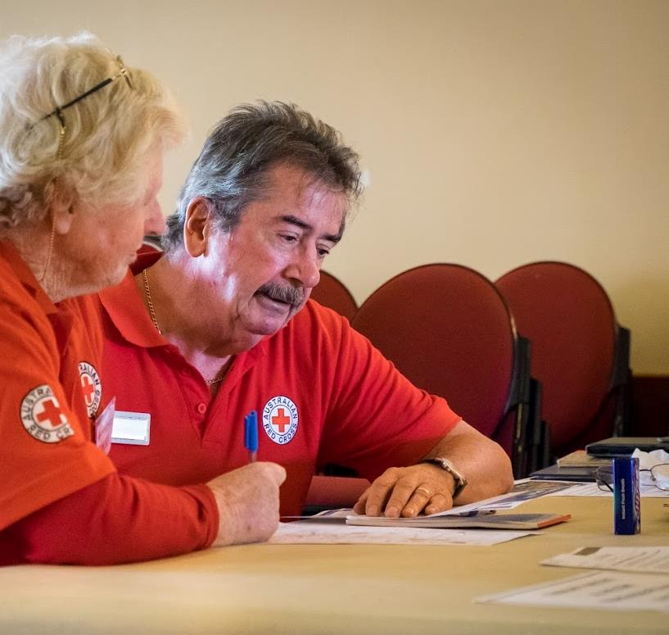
planning and
preparedness
Notes:
Image source: DHHS

Slide 5
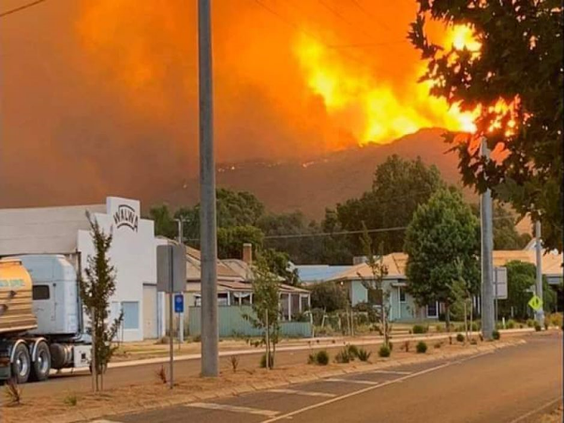
Understanding your responsibilities
planning
Responsibilities will vary depending on the type of service you have. Can be:
  Legislative or Regulatory
  Contractual
  Policy based.
Health and Human Services Sector Emergency Management Policy covers organisations with a relationship to the department.
For State, regional and local government: The Emergency Management Legislation Amendment Act 2018 takes full effect on 1 December 2020.
Notes:
Talking points:
As you can imagine the emergency management sector is governed by a set of legislated arrangements.
Similarly for your organisation you are governed by a range of factors – be they legislative/ regulatory, contractual or policy based,
The Health and Human services sector emergency management policy covers organisations that have a formalised relationship with the department – such as your funding agreement.

Slide 6
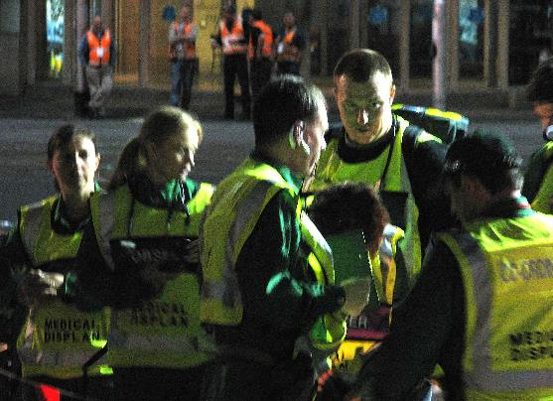
Emergency management decision makers
planning
Know who is responsible for making decisions about your service in an emergency
How is that responsibility delegated? When?
How do staff know who can make decisions about emergencies?
Notes:
If you don't know this information, who would you ask to find out?
In thinking about who the decisions makers are - it is important to consider who they are in your organisation? - eg CEO, Directors, managers.
Are these the same people who will make the decisions during an emergency? If not who then are these people
How do you know who is making decisions during an emergency? Is there an org chart that is shared each day to reflect who is in those roles? Is there a roster?
Where is this information – your plan, rosters, org charts, procedures – kept, Is it easily accessible?
Has this information – contents and location – been clearly articulated throughout your organisation - is there a shared knowledge of what to do when and who makes those decisions
Has this, or relevant parts of the information been shared with client families?
Having clear structures and processes that are widely known and practiced is vital at times of heightened activity and stress. We are not always thinking as clearly as we normally would

Slide 7






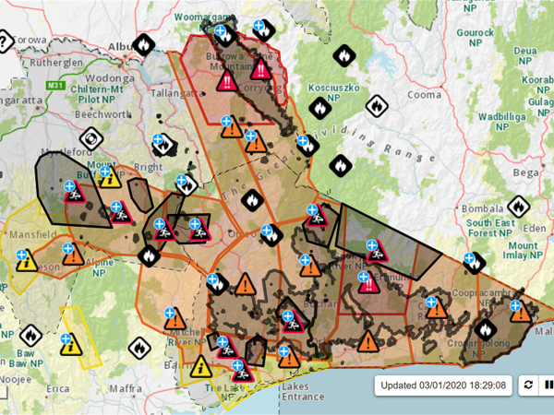



identify hazards
Extreme heat
Bushfire and grass fire
Flood
Storm
Epidemic thunderstorm asthma
Blue-green algae
Communicable diseases
Arboviruses
Power disruption
Notes:
All of these hazards have been experienced at some time across the East Division. Some of them are quite regular occurrences – fire, storm, extreme heat, flood
Spring and summer present a number of these hazards. Sometimes these hazards might occur at the same time or while you are recovering from a previous event. We have seen it this year – as many were starting the recovery journey from the fires at the beginning of the year COVID 19 descended upon us – requiring us all to think and act differently. The recent storms in Eastern Metro also presented some new scenarios for how we manage in a COVID environment whilst responding to and supporting our teams to respond to emergencies
It is important for you to consider how your organisation will manage if more than one event happens at the same time and in a COVID environment.

Slide 8

Can people leave home in an emergency?
YES - Safety of people is paramount
During an emergency people are exempt from the direction to stay at home
www.dhhs.vic.gov.au/emergencies-and-coronavirus-covid-19
Will COVID-19 affect my emergency plan?
Plans should:
Consider any changes to services/working arrangements due to COVID-19
Aim to meet the Victorian Chief Health Officer directives wherever possible
Be adaptable and capable of managing throughout a spectrum of more stringent to less stringent public health control measures
Coronavirus considerations
Notes:
One hazard we have all become familiar with this year is coronavirus. It is important to be aware that in the presence of COVID-19 restrictions, the safety of people and communities is always paramount in emergencies.
During an emergency where it is unsafe to stay at home, people are exempt from the Direction to stay at home, and other directions under the emergency provisions. This includes allowing people to stay with family and friends. We recognise that there may have been some confusion over this in the past.
Key points to confirm:
You can leave your home during an emergency or if your home is unsafe.
If a fire, flood, storm, power outage or other emergency impacts your health or safety, or the health or safety of someone you live with, you can travel to a friend or family member’s house.
If you require power for life support or a ventilator you can travel to a friend or family member’s house who has power.
If you have been impacted by power outages and need relief support, contact your power distribution company or your local council.
More information can be found on the DHHS Emergencies and coronavirus page (www.dhhs.vic.gov.au/emergencies-and-coronavirus-covid-19). Those evacuees under a specific Direction to isolate need to contact the department as soon as possible to advise relocation arrangements.
COVID will likely impact your current emergency plan. Take time to review your plan and ensure if reflects any changes to services/working arrangements due to COVID-19.

Slide 9
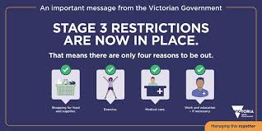
General principles:
Good hand and respiratory hygiene
Physical distancing – maintain at least 1.5 metres
Special arrangements for individuals who must self-isolate or quarantine
PPE – have necessary protective equipment e.g. masks, gloves etc.
Cleaning of surfaces and other areas in the facility, including correct biohazard waste management
If unwell or have symptoms, do not attend work, get tested.
Coronavirus considerations
Notes:
Talking points:
When reviewing emergency plans, including plans to relocate clients, consider the general public health principles
For more information visit https://www.dhhs.vic.gov.au/coronavirus,
Understand what level of restrictions you are in
Are your relocation plans appropriate
Transport arrangements – considering social distancing requirements
What extra considerations
PPE
Social distancing
Additional cleaning
Concerns from family and friends of clients/ communication with family of clients
Are any of your clients in quarantine or self isolation? What considerations are required if relocation is necessary

Slide 10

Assessing Risks
For each hazard:
Assess the likelihood of an event happening
Determine the consequences
Use the matrix to identify a risk rating
Notes:
Talking points:
Assess the likelihood of events happening.
Has it happened before? Could it happen again?
Climate change increasing frequency, duration and severity of some types of emergencies
Help to determine likelihood – Local government planning/history, emergency services agencies, BoM forecasts, local knowledge etc
Consequences
What could happen if no action is taken?
Risk rating
Cross reference likelihood and consequence on the table
Think about your client profile and their particular circumstances – do these considerations increase or change the risk
Appendix 3 of the Reference Guide has been designed as a template to help with risk assessment if your organisation doesn’t already have something in place

Slide 11
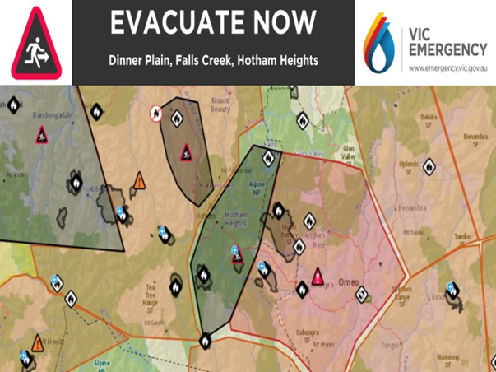
planning a response
Ensure continuity of care
Alter or cease service delivery
Relocation, sheltering, evacuation
Client safety planning
Coronavirus restrictions and directions
Check the latest guidelines and plans
Consult and engage with key stakeholders
Notes:
What does continuity of care look like for you?
Do you have enough staff to respond to an emergency?
Are you able to keep patients safe?
Do you have a working generator or access to one?
Can you give medication or support that is needed?
Are your relocation plans appropriate? Can you maintain appropriate social distancing in your transportation plans.
Be aware of the latest coronavirus restrictions and directions that are in place for your local area and surround
Are any of your clients in quarantine or self isolation? What considerations are required if relocation is necessary
What information have you provided to family of clients about your plans during an emergency
Reference guide gives a lot more information.
Please go to https://www.dhhs.vic.gov.au/coronavirus for more information.

Slide 12
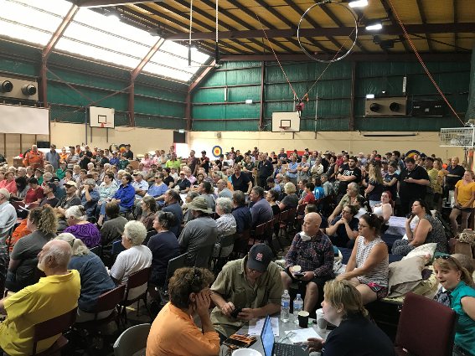
Clients who live in their own homes
Some clients face greater risk because of personal and/or locational factors
Conversations to raise awareness about emergency preparedness can be had during everyday client interactions
Involve informal support networks and community-led programs to make plans
Gaps in support networks can provide direction for preparedness through formal support and advocacy
Planning resources include:
  Person-Centred Emergency Preparedness Toolkit
  Bushfire planning – How to support your clients (CFA)
  Rediplan - Australian Red Cross
Notes:
Service providers are a trusted source of advice and support to their clients who are supported in their homes.
Good planning is the best way to increase the safety of those you support. Being prepared can improve recovery.
Talk with your clients regularly about getting ready for emergencies as part of routine visits.
Know their risk: For example, do they live in a bush fire, flood or heatwave area? Do they have specific circumstances or medical conditions that put them at greater risk in different types of emergencies.
Identify their needs: Ask your clients what they will be able to do for themselves in an emergency and what extra help they may need. For example, can they access and understand emergency information and warnings? Can they keep themselves safe or evacuate if needed? Are they connected with family, friends or neighbours who can help?
Help them to prepare: This may involve assisting clients, particularly those at greater risk to:
complete an emergency plan
involve their family, friends or other support networks
explore opportunities to link clients into local initiatives which will support their safety and wellbeing
connecting them with emergency planning assistance from another organisation, such as the Australian Red Cross or an advocacy agency.

Slide 13
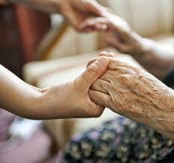
Vulnerable Persons Registers
Tools used by Victoria Police for local evacuation planning
Administered in 64 LGAs (rural and semi-rural)
Designed for clients most at risk who are unable to put plans in place with necessary supports to leave early or respond in an emergency
Service providers add and maintain accurate information for their clients (April and October revalidation processes)
Client consent is required
Notes:
Clients with conditions which limit their ability to comprehend or act on emergency warnings are at greater risk of injury or death during an emergency.
Leaving early is always the safest option for clients at greater risk, especially on extreme and severe fire danger days and certainly before a Code Red day.
The Vulnerable Persons Register is used to support evacuation planning by emergency services for individuals who are unable to leave early when an emergency arises.
The close relationship between service providers and their clients means service providers are well-placed to understand their client’s needs and resources and whether they meet the criteria for inclusion on the Register. If clients do meet the criteria of not being able to comprehend or act on emergency warnings they must also consent to being included.
The Register is supported by The Vulnerable people in emergencies policy.
Your local government can assist you information on the Register and whether your clients may meet eligibility criteria. In most cases only a small number of your clients may meet the criteria.

Slide 14
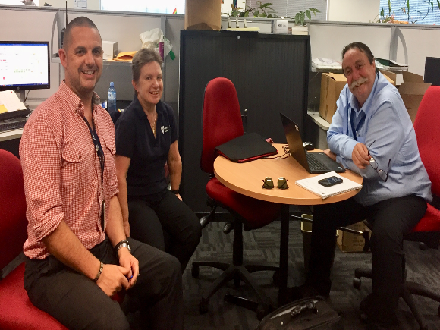
preparedness
The actions you need to take to mitigate your risks or be ready to implement your plan include:
Undertake property maintenance
Order supplies, including PPE
Prepare evacuation kits
Check back up generator supply
Training and exercises
Communicate.
Notes:
Being ready before any emergency is the critical.
At the commencement of, or during an emergency is not the time to pack to evacuate or to think about clearing properties etc.
Things to consider:
Undertake property maintenance now and continue during the season
Ensure adequate supplies on hand
Evacuation kits packed and located in known, easily accessible place
Checking/ testing generator and having adequate fuel supplies to keep it running
Training and exercising so everyone knows what to do
Good communications

Slide 15
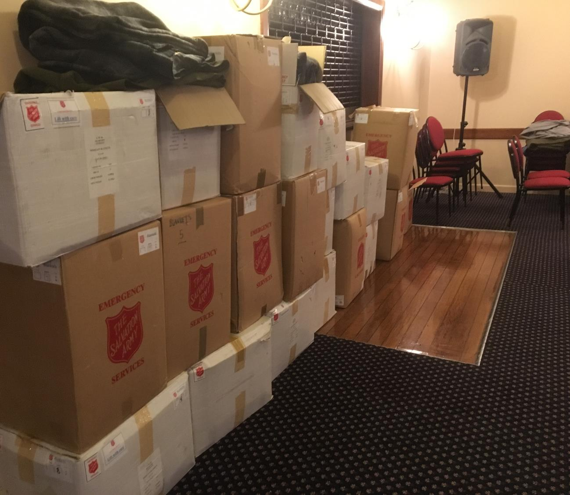
readiness

Slide 16
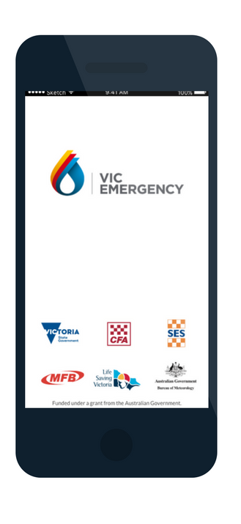



Emergency Readiness
Review your plan
Maintain awareness of local situation
Subscribe to alerts
Communicate
Notes:
Review plan and confirm it is located where it should be
Ensure everyone knows their roles and responsibilities
Having access to multiple sources of information can help you remain informed and confident about your local conditions.
The Chief Health Officer has Health alerts which you can subscribe to. VIC Emergency offers local information about emergencies.

Slide 17
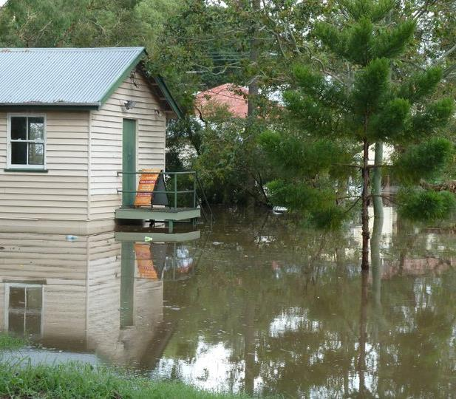
during an emergency

Slide 18
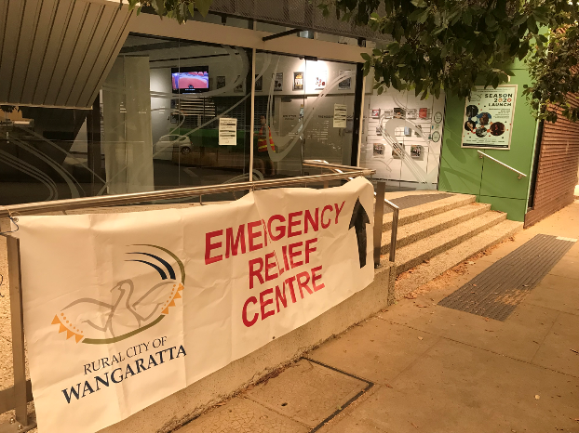
during an emergency
Continue to monitor conditions
Activate your plan – respond to the situation
Confirm decision making arrangements
Communicate
Notes:
Continue to monitor conditions
Activate your plan
As much as possible keep stakeholders informed of what is happening, whether you are activating your plans, will you relocate – have you been advised to relocate
Don’t wait to be told to leave or take appropriate action

Slide 19
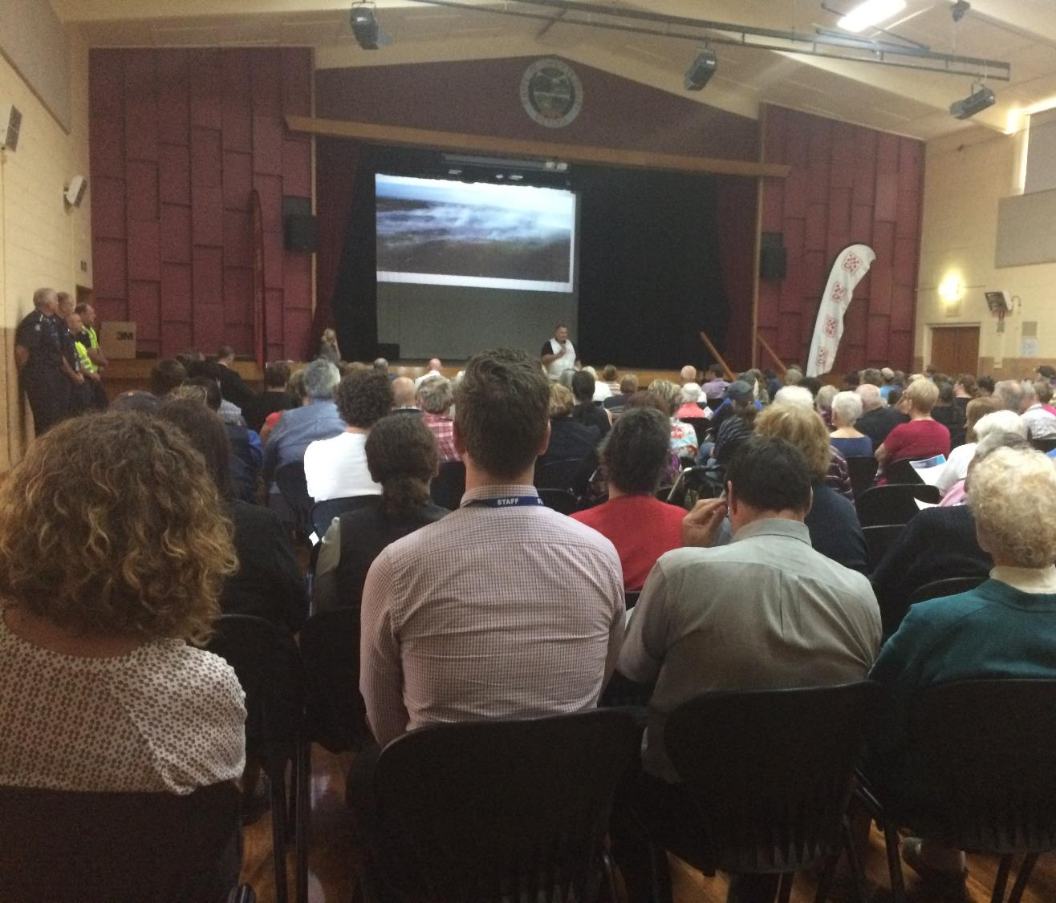
after an emergency

Slide 20

After emergencies
Checking on client and staff welfare
Returning to business as usual
Debriefing about lessons learned
Reviewing and updating plans
Notes:
Clients and staff – fatigue management from extended period of high emotion
If you have relocated during an emergency remember to advise relevant stakeholders that you have returned and everyone is safe
Debriefing – asking what worked well/what could we do better next time? Think about who should be involved in the debrief.
From these learnings update your plans – do this as soon as possible after the debrief rather than leaving it until a later date.
Remember to exercise these updates.

Slide 22
To receive this publication in an accessible format phone 9096 , using the National Relay Service 13 36 77 if required, or email empolicy@dhhs.vic.gov.au
Authorised and published by the Victorian Government, 1 Treasury Place, Melbourne.
© State of Victoria, Department of Health and Human Services August 2019
Except where otherwise indicated, the images in this publication show models and illustrative settings only, and do not necessarily depict actual services, facilities or recipients of services. This publication may contain images of deceased Aboriginal and Torres Strait Islander peoples.
Where the term ‘Aboriginal’ is used it refers to both Aboriginal and Torres Strait Islander people. Indigenous is retained when it is part of the title of a report, program or quotation.

