Slide 1
Learning Session: CIMS Review update
CIMS Review team, Quality, Improvement and Oversight
Aboriginal Initiatives, Quality, Improvement and Oversight
Children and Families Division
November 2024
OFFICIAL

Slide 2
Acknowledgement of Traditional Owners
We acknowledge the Traditional Owners of the lands that we live and work on. We pay our respects to their Elders, past and present.
We acknowledge the invaluable contributions of Aboriginal communities and their allies who have paved the way and fought for the rights of Aboriginal people, including the right to self-determination. The Department of Families, Fairness and Housing is committed to ensuring Aboriginal people, children, young people, families and communities continue to thrive and that our work is underpinned by self-determination.

Slide 3
Presentation overview
Purpose
Overview of session
The new CIMS policy was published on 11 October 2024, with the new requirements commencing 9 December 2024.
The new policy should be reviewed in detail. This presentation is intended to provide key highlights and is not exhaustive.
Provide an overview of the key changes following the CIMS review.
Outline the implementation supports available for the transition to the new requirements.
This presentation focuses on the following key changes:
Roles and responsibilities framework
Incident types
Major impact incident follow up actions
Implementation of learnings
CIMS IT changes

Slide 4
Overview of CIMS Review
*Figure displays the goals of the CIMS Review
Client safety
Strengthen alignment with the CIMS purpose statement
Reduce duplication of effort
Improve investigation requirements
Clarify roles and responsibilities
Embed analysis and learning from incidents into policy
Improve training and guidance
The purpose of CIMS is to safeguard clients by providing timely and effective responses to incidents which harm them during service delivery, which in turn, enables service providers to enhance service delivery by learning from incidents.
Overarching goal of the CIMS Review was to address some of the barriers which prevent CIMS from working as best it can.
The CIMS Review has been conducted in close consultation with stakeholders. Stakeholder feedback has shaped review outcomes. At times, feedback has been competing.
CIMS review outcomes have been strictly prioritised to bring the greatest benefit to clients.

Slide 5
Overview of CIMS Review outcomes
The following outlines some of the key outcomes from the CIMS review:
 | Introduced a new layout to the CIMS policy document which separates policy from implementation guidance |  | Aligned CIMS with parallel incident reporting requirements as much as possible, including allowing a Reportable Conduct Scheme to be submitted as the CIMS investigation.
 | Embedded Aboriginal cultural safety in CIMS by introducing a new CIMS principle of Aboriginal self-determination, voice and cultural safety. This principle informed the policy and implementation guidance throughout the new policy |  | Prioritising client voice introduced as a new CIMS principle and strengthened support for carers by requiring explicit consideration of carer needs throughout CIMS.
 | Clarified the roles and responsibilities for each layer of CIMS, reducing ambiguity and strengthening the collaborative approach to client safeguarding. |  | Updated definitions, including a clearer incident classification and interpretation of the harm experienced by clients, facilitating consistent and proportionate responses to incidents.

Slide 6
Roles and responsibilities framework.
OFFICIAL

Slide 7
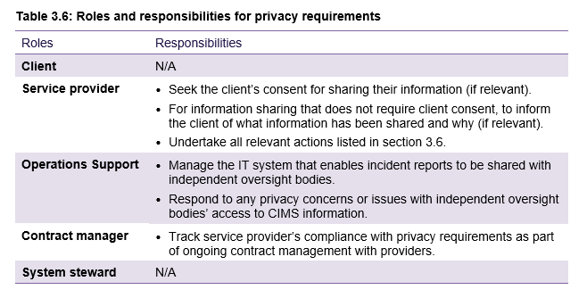
CIMS roles and responsibilities
The CIMS policy sets the framework for the layers of CIMS to work together to safeguard clients
Each policy section contains the roles and responsibilities for each layer of CIMS
Services providers are responsible for:
effectively responding to, reporting and managing incidents.
learning from each incident, to improve services and the quality-of-service delivery.
CIMS incident reports, investigations and reviews are service provider documents.
* Figure displays an example of the roles and responsibilities table in each policy section.
OFFICIAL

Slide 8
Incident types.
OFFICIAL

Slide 9
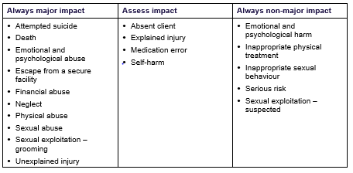
Key changes to incident types
The following outlines the key changes to incident types:
Removal of incident types:
Dangerous actions – client
Poor quality of care
New incident types:
Neglect
Sexual exploitation – grooming
Sexual exploitation – suspected
Separation of combined incident types:
Injury
Self-harm/attempted suicide
Mandatory classification of incidents
Classifications table for incident types :
OFFICIAL

Slide 10
Removal of dangerous actions incident type
The below outlines the reporting options following the removal of the ‘dangerous actions – client’ incident type:
Abuse categories
Sexual exploitation – grooming
Dangerous actions -
Client
(not an incident type from 9 December 2024)
Major impact
Explained injury ​
Assess impact
Non-major impact
Serious risk
Sexual exploitation – suspected
OFFICIAL

Slide 11
Removal of poor quality of care incident type
The below outlines the reporting options following the removal of the removal of poor quality of care incident type:
Abuse categories
Neglect
Poor quality of care
(not an incident type from 9 December 2024)
Major impact
Injury:
Unexplained injury (major impact)
Explained injury (assess impact)​​
Assess impact
Non-major impact
Serious risk
OFFICIAL

Slide 12
New sexual exploitation incident types
What are the differences?
Why have the changes been made?
Sexual Abuse incident type:
Now includes sexual exploitation for clients under the age of 18 and/or with cognitive disability, recognising exploitation is a specific form of sexual abuse
New Sexual exploitation – grooming incident type:
Mandatory incident classification of major impact
Aligns with Child Protection Tier 1 sexual exploitation response
New Sexual exploitation – suspected incident type for clients under 18:
Mandatory incident classification of non-major impact
Aligns with Child Protection Tier 2 sexual exploitation response
CIMS has strengthened the identification and response to children who are, or at risk of being, sexually exploited. The incident types have been aligned with the Child Sexual Exploitation Response delivered by the Office of Professional Practice
Sexual exploitation for under 18s is sexual abuse due to the power imbalance in the relationship impacting or impairing the client’s ability to provide informed consent.
The sexual exploitation of adult clients is to be reported under the sexual abuse category.
OFFICIAL

Slide 13
Major impact follow up actions.
OFFICIAL

Slide 14
Major impact follow up actions
Change in investigation focus from 9 December 2024
All major impact incidents are subject to an investigation or incident review.
An investigation must be undertaken for incidents or allegations of:
Any abuse incident type, including sexual exploitation – grooming, when the subject of allegation is a staff member (including carers) or client
Neglect
Unexplained injury
An incident review must be undertaken by all major impact incidents that are not subject to an investigation.
Substantiation of whether the abuse or neglect occurred is based on the incident type definition.
The impact on the client (Major / Non-major) does not need to be included in the substantiation decision, unless it is directly referenced in the incident type definition.
Example:
To substantiate an allegation of sexual abuse, the findings of the investigation must demonstrate that a client has experienced sexual abuse as per the CIMS definition.
The findings do not need to demonstrate major impact on the client as it is reasonable to assume that the client has experienced major impact harm from the incident.
For noting:
Two incident types reference the major impact harm definition (physical abuse and neglect)
Where the incident type definition references ‘major impact’ service providers are required to use professional judgement to determine if a client has experienced major impact harm when making a substantiation decision.
OFFICIAL

Slide 15
Streamlined investigation requirements
The following displays the workflow for service providers to conduct a follow-up action to a major impact incident.

Slide 16
Streamlined investigation processes
What are the differences?
Why have the changes been made?
Reducing the re-traumatization of clients and subjects of allegation by having to retell their story multiple times for different investigative purposes
Reducing duplication of effort, administrative and investigative burden
Option for service providers to conduct a Reportable Conduct Scheme investigation in place of a CIMS investigation for incidents in scope of both schemes
Requirement for explicit recognition of client and/or subject of allegation vulnerabilities
Previous CIMS guide
New CIMS policy
Four types of ‘CIMS’ investigations:
Full investigation: internal
Full investigation: external
Short form investigation
Joint investigation
Streamlined investigation requirements:
CIMS investigation
Reportable Conduct Scheme investigation
Joint investigation
OFFICIAL

Slide 17
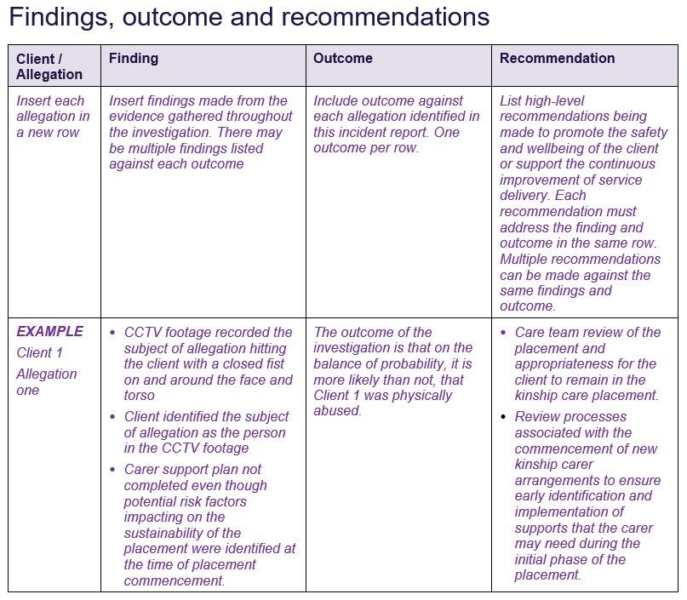
Completing the report
Example of how to complete report:
Findings, outcome and recommendations
The incident report templates have been amended to streamline the findings, outcome and recommendations section
A response and action plan is no longer required to be submitted to the department.
Service providers will continue to enact response and action plans as part of their case management.
OFFICIAL

Slide 18
Incident reviews
What are the changes?
Why have the changes been made?
Case reviews have been renamed to incident reviews to increase the focus on the situational and systemic factors that have contributed to the incident
Root Cause Analysis’ have been removed.
Implementation guidance has been strengthened to enhance service provider review processes
Existing case management processes can be leveraged to satisfy components of an incident review:
Return to care conversations (absent client incident type)
Tier 1 sexual exploitation response (sexual exploitation – grooming)
Strengthening the benefit of incident reviews to enhance the quality of services and service delivery
Synthesising existing processes to produce a comprehensive review report which reduces the fragmentation of information
Enhancing the utility of the review report to inform practice and system improvement.
OFFICIAL

Slide 19
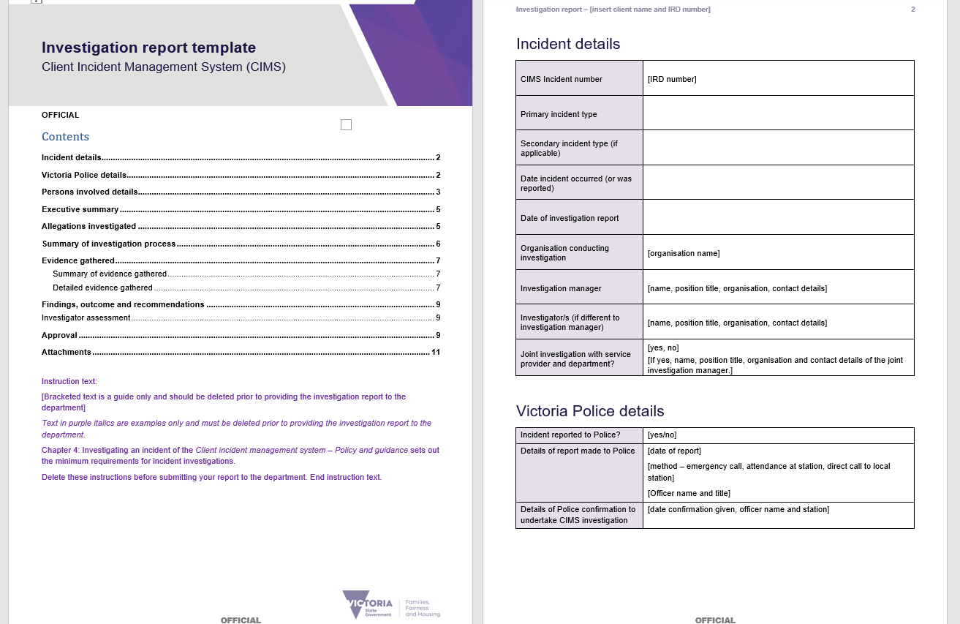
Support for investigation changes
Example of investigation report template :
Refreshed templates are available on the CIMS webpage https://providers.dffh.vic.gov.au/cims.
Service providers may use their own investigation templates, if all the CIMS minimum investigation requirements are met.
A new eLearning module is available on the CIMS webpage to support new and infrequent investigators.
OFFICIAL

Slide 20
Implementation of incident learnings.
OFFICIAL

Slide 21
Implementation of learnings
What are the changes?
Why have the changes been made?
Response and action plans integrated into Chapter 6 Implementation of Learnings
Implementation of learnings reflect both client and organisation level learnings
Articulated the department’s use and sharing of CIMS incident information
Streamlining case management activities to reduce duplication of effort to maximise client safeguarding
Strengthening learnings at all levels of the organisation and service
Improving the transparency of the department’s use and sharing of CIMS incident information.
OFFICIAL

Slide 22
CIMS IT changes.
OFFICIAL

Slide 23
Key changes to the CIMS IT system
Changes to support the new CIMS policy
New drop-down options for existing fields:
'other client participant’ option to move away from criminalising or blaming language for client-to-client incidents
New incident types (such as Neglect, Sexual exploitation – grooming)
Removal of old incident types (such as Dangerous Actions). Note: existing incidents with these incident types on 9 December will need to be completed and finalised, for example, investigated or reviewed.
Validation rules to reduce unnecessary rework caused by selecting a classification (Major / Non-major) which is not allowed by CIMS policy.
Other changes
CRIS ID will be mandatory for out of home care clients to improve identification of clients
New field to record the Social Service Regulator’s Critical Incident ID number
OFFICIAL

Slide 24
Implementation activities.
OFFICIAL

Slide 25
Implementation activities
Key implementation topics
Policy definitions
Policy requirements
RCS investigations accepted in place of CIMS investigations
Incident review
Clarification of roles and responsibilities
Planned implementation activities
Updated CIMS e-learning modules Updated purple flip books (summary guide) Targeted learning sessions will be offered to service providers in November 2024, focusing on the changes made by the CIMS Review and example scenarios. Updated investigation and reporting templates

Slide 26
Further information
Key contacts for further questions
CIMS questions and practice guidance requests: StatewideCIMS@dffh.vic.gov.au
CIMS Review questions: CIMS.Review@dffh.vic.gov.au
Resources
CIMS webpage https://providers.dffh.vic.gov.au/cims has guidance and resources which will be progressively updated
New CIMS policy: Client Incident Management System: policy and guidance (Word) https://providers.dffh.vic.gov.au/client-incident-management-system-policy-and-guidance-word
Updated CIMS elearn: CIMS eLearning module https://cims.dffh.vic.gov.au/.
New investigations elearn: Conducting a CIMS Investigation eLearning module.
Information sheet on the November Learning Sessions (Word) https://cimsinvestigation.fly.dev/story.html.
If you would like to subscribe to the CIMS Review newsletter, please email CIMS.Review@dffh.vic.gov.au

