Slide 1
Case management program requirements for specialist family violence services which support victim survivors
Information for SFV services
February / March 2022
Notes:
This is an introductory session to the Case management program requirements.
We have had a request tor record this session, so before we push the record button, I just wanted to check there were no concerns with doing this?
We hope to get you up to speed on their development, where we are at today, and our planned implementation approach.
To start with, Ange O’Brien will walk you through some background information and tell you a bit more about the program requirements. Ange will spend a bit of time on this part – we know it can be difficult sometimes to find time to read and digest a document such as this.
I’ll then expand on the information pack recently sent to you by your local APSS contacts, and what we are asking of you this year and into next.
Ellen McGregor and Gaye Ealy from Safe and Equal will then talk about the implementation support Safe+Equal will be able to offer to members.
We will also look briefly at the implementation timing against some other key pieces of work – namely the crisis responses and after-hours - so you can see how these sit together and what to expect this year.
We’ll wrap up with some key messages and a Q&A session.
We have adjusted the implementation milestones in response to feedback from APSS managers and Implementation Leads at a preliminary DFFH briefing session on 10 February, and these changes are reflected in this presentation.
Feel free to use the chat to flag questions you’d like to ask along the way, or suggestions you might have about anything. We’ll pick these up at the end.
We will also pause at certain points to ask for your reflections on a few points.
We want this to be a two-way conversation so we can get the implementation approach right.
We’ll make these slides available to participants shortly.

Slide 2
Background
In 2018, FSV contracted Urbis Pty Ltd to consult with specialist family violence services in Victoria to inform the development of comprehensive case management guidelines for use by agencies funded to deliver specialist family violence case management.
In late 2019, FSV partnered with Safe+Equal (formerly DV Vic) to review and rework Urbis’ draft guidelines to ensure alignment with new MARAM practice guides and resources, and the Code of Practice.
The reworked document, now known as the Case management program requirements, was recently released to the sector together with more detailed information about the proposed implementation approach.
Notes:
In 2018, FSV asked Urbis to develop a set of case management guidelines that would support specialist family violence services to deliver family violence case management in line with a set of universal quality criteria.
Urbis set about identifying the defining features of specialist family violence case management, describing these as:
the ongoing assessment of risk posed by the perpetrator to the victim survivor and any children/dependents, and
the development and activation of risk management plans and safety plans with the victim survivor to address this risk.
Through its engagement with the sector and a detailed literature review, Urbis also:
Defined the scope of practice in the case management model through the use key domains, covering the common areas of practice – linked to need – that victim survivors frequently need to navigate
Identified several stages of specialist family violence case management, encompassing the processes used to continually assess risk, support clients to increase their safety, reduce their risk, be empowered to regain control of their lives and choices, and work towards healing and recovery
Articulated how the intensity and duration of support should align with each victim survivor’s circumstances and needs.
Urbis’ work was undertaken within an environment of significant reform across the family violence and broader social services system, and coincided with the development of several new MARAM practice guides and resources. For this reason, upon receiving Urbis’ draft guidelines FSV commenced a mapping exercise to identify the intersections of this broader work, and this highlighted a level of duplication and some inconsistencies which needed to be addressed.
A comprehensive reworking of Urbis’ draft guidelines was undertaken as a partnership between FSV and Safe+Equal. A small project team overseen by a joint FSV / Safe+Equal Governance Group was established to progress this work, with expert input from a broad based sector advisory group comprising family violence accommodation services, local specialist family violence services (rural and metro), together with a number of statewide services.
We now would like to expand on some of the key aspects of the document before taking you through the proposed implementation approach.

Slide 3
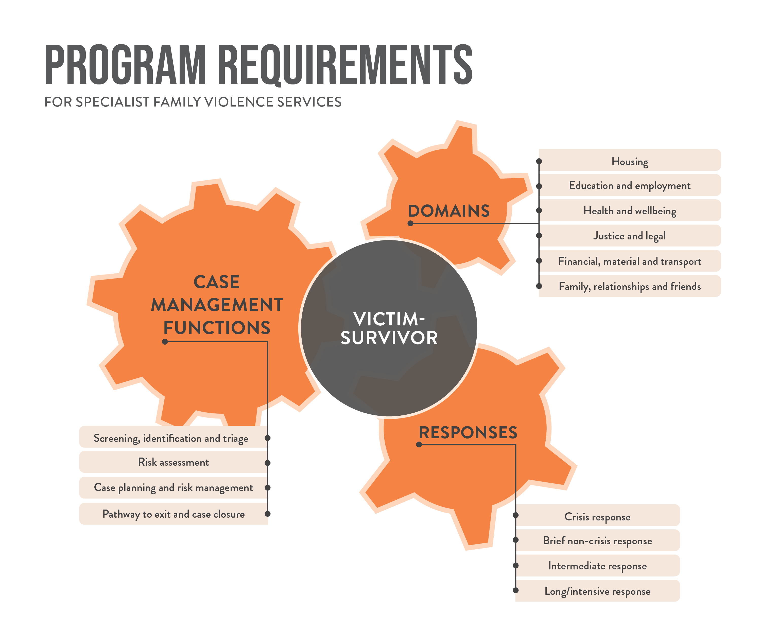
Program requirements - Structure
Areas of victim-survivors’ lives that are impacted by perpetrators’ violent behaviour. Protective factors.
Engaged by services to respond to victim-survivors from entry to exit in the service journey.
Duration and intensity of the support provided by services.
Case management activities are not linear or cyclical –
they respond to victim survivors’ risk, needs and circumstances.
Notes:
Pitched at the organisational level, the Case management program requirements are designed to be a comprehensive guide or case management ‘manual’ for service managers, describing the ‘what’ agencies need to do to ensure quality case management service delivery.
They are aligned with the Code of Practice (which describes the ‘why’) and MARAM Framework (which describes the ‘how’). All three share similar goals, which are to:
engage with evidence-based best practice
enhance quality service provision
enable state-wide consistency.
They have been structured around three core inter-related components that respond to victim survivors’ risk, needs and individual circumstances, taking into consideration the settings, situations, and impact of family violence on them.
Responses: Describe the duration and intensity of the case management support provided by services, which is often influenced by risk, complexity and a victim survivor’s readiness. It includes crisis responses as part of case management and recognises that “crisis” can occur at any time of victim survivors’ journey, even when a victim survivor is receiving a long-term response.
Functions: Describe case management activities which are engaged to support victim survivors from entry to exit in the service journey. These functions are key in helping to link Responses and Life Domains. They are not necessarily linear or cyclical because victim survivors’ risk, needs and circumstances can change at any time.
Life Domains: Describe victim survivors’ safety and support needs across their life domains with an intersectional lens, taking into consideration the impact of perpetrators’ violent behaviour and ongoing complexities and barriers they face when seeking help. Life Domains become needs that should be addressed in a coordinated way, but if they are not impacted, they may represent protective factors and strengths that could be maximised.
For victim survivors, they will deliver more consistent, equitable and accessible quality services across the state, no matter where they live or what support they need.
For Case management services, they provide a set of comprehensive, universal quality criteria which comprise value indicators at every stage of client support and links to essential tools and additional guidance.
For Government, sector partners and stakeholders, they synthesise the extensive reforms to the specialist family violence service system through quality performance indicators, incorporating legislative and policy changes and funding boosts which support victim survivors to recover and stay safe.

Slide 4
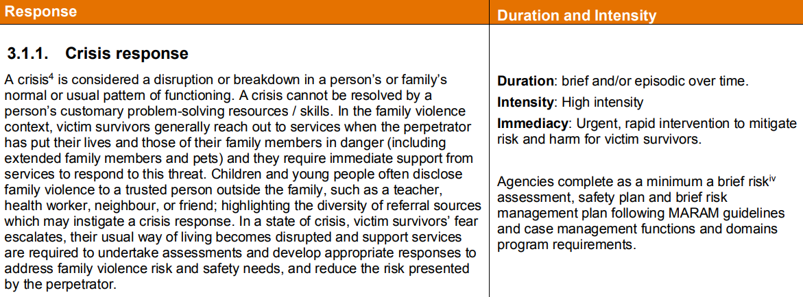
Program requirements – a closer look at Responses
Responses describe the intensity and duration of support provided by a service. Example: 3.1.1 Crisis response:
Notes:
Responses include:
Crisis response
Brief non-crisis response
Intermediate or longer-term response, and
Intensive response
In this instance we are using an excerpt from page 20 – Crisis response - as an example.
A crisis response is provided to victim survivors in crisis situations who are assessed to be at ‘serious risk’ and / or at a family violence crisis point from risks posed by perpetrators. A crisis response is clearly positioned as part of case management in recognition that “crisis” can occur at any time of a victim survivor’s journey.
A crisis response may include:
temporary alternative emergency accommodation (including family violence accommodation services, such as crisis accommodation and refuges, or motel accommodation) for victim survivors who are unable to stay in their usual residence
hospital outreach, encouragement and support to see a GP, referrals to a mental health service or alcohol and drug services for victim survivors experiencing health crises
Police assistance, applying for an intervention order, court support or referral to a legal service for victim survivors experiencing justice crises.

Slide 5
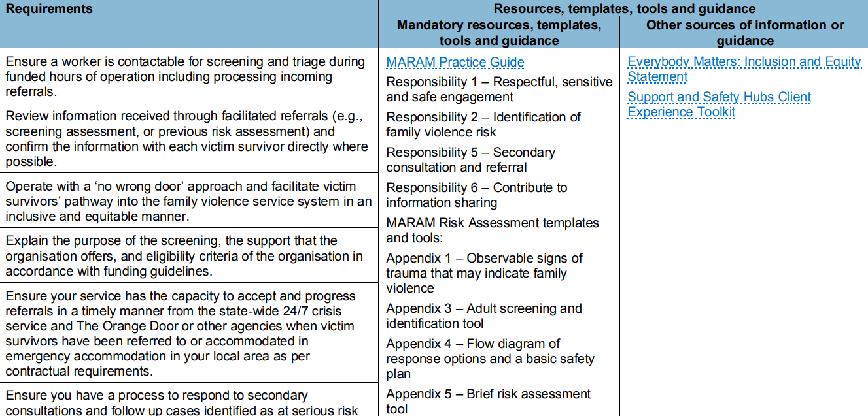
Program requirements – a closer look at Functions
Functions essentially describe how services partner with victim survivors on their journey to safety. Example: 3.2.1 Screening, identification and triage:
Notes:
Functions include:
Screening, identification and triage
Risk assessment
Case planning and risk management, and
Pathway to case closure
Functions essentially describe how services partner with victim survivors on their journey to safety.
In this instance we are using an excerpt from page 26 – Screening, identification and triage - as an example.
Screening, identification, and triage is a process used by specialist family violence services to identify or confirm whether an individual or family is at risk of family violence and in need of specialist support. The process determines a service response based on each adult and child victim survivor’s identified risks, needs and unique circumstances..
Links to mandatory resources, templates, tools and guidance are provided under each Function, together with other sources of information and guidance.

Slide 6
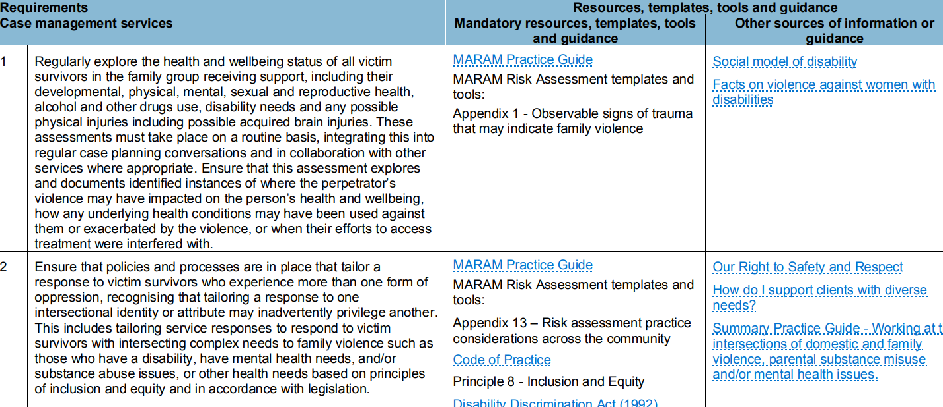
Program requirements – a closer look at Life Domains
Life Domains describe victim survivors’ safety and support needs across key everyday life areas. Example: 3.3.2 Health and Wellbeing:
Notes:
Life Domains include:
Housing
Health and wellbeing
Family, social and community connections
Employment and education
Financial, material and transport
Justice and legal
Life Domains describe victim survivors’ safety and support needs across key everyday life areas, and may also represent protective factors and strengths that should be maximised through case management support.
In this instance we are using an excerpt from page 61 – Health and wellbeing- as an example.
Supporting victim survivors to address their physical and mental health needs as well as access to health services is an essential part of service delivery. Services are expected to respond by supporting victim survivors to identify the impact of the perpetrator’s violence on their own physical, and mental wellbeing, assess their needs and strengths in these areas, advocate on their behalf, and develop a case plan goals that are aligned to their unique risk and circumstances with an intersectional lens.
Again links to mandatory resources, templates, tools and guidance are provided under each Life Domain, together with other sources of information and guidance.

Slide 7
Additional requirements for working with children and young people, and for accommodation services (refuges)
In areas where children’s unique, specific needs warrant extra requirements, these are highlighted in a different coloured box as additional requirements throughout the document. For example:
In some areas of case management, family violence accommodation providers will attract additional requirements associated with their specific service delivery setting – these are also highlighted separately throughout the document. For example:
Notes:
In areas where children’s unique, specific needs warrant extra requirements, these are highlighted in a different coloured box as additional requirements through the document.
Victim survivors in the family group is a term used to be inclusive - A family group may comprise any number of adults, children and young people, including two adults not in an intimate partner relationship or a single person.
We used Adult victim survivor when talking about the ‘carer role’ based on feedback of the advisory group and governance group.
In some areas of case management, family violence accommodation providers will attract additional requirements associated with their specific service delivery setting – these are also highlighted separately throughout the document.

Slide 8
High level timeline – revised milestones
By end June, self-assess the alignment of existing operations and procedural documentation with the program requirements using self-audit tool (previously by end April).
By the end of September, provide an Action plan to local APSS that, at a minimum, incorporates changes required to align their operations and procedural documentation with the program requirements (previously end June).
By end December, finalise operations and procedural documentation updates and commence preliminary activities to embed the program requirements (for example, via awareness raising activities with internal teams (previously by end September).
In the first three months of 2023, review Action plans for completeness and update as required with further actions to fully embed the program requirements into organisational service delivery practices alongside work for MARAM and the Code of Practice (previously by end December).
Notes:
Much of the information about implementation timeframes for the Case management program requirements was described in the Addendum to the Q&As distributed to agencies by DFFH Divisions.
FSV recently met with DFFH divisional colleagues to obtain preliminary feedback about the proposed implementation approach and milestones. In light of feedback from APSS about concurrent departmental demands on agencies through to June / July, and in recognition that agencies are experiencing service capacity constraints and high case loads, we are proposing some changes to these milestones. These changes are reflected in this slide.
My main point of focus is to update you on these changes, and to seek your feedback about the revised milestones.
In short, the revised milestones seek to provide additional time for agencies to take the first steps along the journey to embedding the Case management program requirements into their organisational service delivery practices.
Consistent with the MARAM framework, we are following a maturity approach - agencies can identify further actions to more thoroughly embed the program requirements at any stage - for example when doing the self audit of the alignment of operations and procedural docs, or when developing their action plan, or later in the piece when reviewing their action plans.
Question for participants: Do these revised timeframes seem reasonable?

Slide 9
Developing an Action plan
Case management program requirements - combined mapping document, self audit tool and action plan
Notes:
The Addendum to the Q&As also mentioned two key documents to support agencies with the implementation of the case management program requirements:
A ‘principle and micro level mapping document’ and ‘combined audit tool’, and
A blank agency implementation plan which can be used to step out each agency’s planned alignment activities – effectively an action plan.
For now, we have merged these documents into a single document titled ‘Case management program requirements - combined mapping document, self audit tool and action plan’. We distributed this document to attendees via email, but we’ll make changes as necessary based on feedback.
As outlined on this slide, beginning at page 7 of this document you will find:
Four mapping columns, where each Case management program requirement has been mapped at the micro level against the Code of Practice Indicators, MARAM milestones and Human Services Standards criteria. These mapping columns are designed to enable agencies to identify any intersecting or related Code of Practice, MARAM or the Human Services work they might be doing and to progress the Case management program requirements work alongside these activities.
Three self-audit columns where agencies can provide an evidence based rating of the alignment of their operations and procedural documentation with the Case management program requirements, and the gaps that need to be addressed
Three action-planning columns where the actions, responsibility and timeframes for addressing those gaps can be recorded.
We are asking agencies to self assess the alignment of their service delivery practices against each of the program requirements, starting with a review of their operations and procedural documentation. Each agency’s self-assessment will inform their Action plan.
We are hoping some agencies will be happy to share their self-audit with the FSV / Safe+Equal Implementation Team (this can be deidentified if preferred) to assist with planning for additional resources and tools to support agencies with this work.
Action plans should at least identify the changes required to align each agency’s operations and procedural documentation with the Case management program requirements. Ideally Action plans will also start to identify some other changes that will be required to organisationally embed the CMPR alongside other MARAM and Code of Practice work.
Safe+Equal will be able to provide some support to agencies in thinking about this second aspect of agency actioning planning, and Ellen or Gaye will talk more about this in a moment.
There is no need to agree on the content of these action plans with local APSS contacts – this is another change from the Addendum to the Q&As based on feedback to date. It will be important however to keep your local APSS contact in the loop about how your action plans are developing and any concerns you might have or assistance you might need so this can be fed back to the FSV / Safe+Equal Implementation Team.
Questions for participants:
How useful does this template look to you, and what could we do to improve it? Feedback from our recent session with APSS suggested that it might be useful to split this document into separate mapping, self-audit and action planning documents, or into a different combination of documents.
Would you be happy to share deidentified templates with the FSV / Safe+Equal Implementation Team to assist us with developing additional resources and tools?

Slide 10
Tools and resources for agencies
Are leading implementation support activities and will be available as a resource for the sector throughout the development of implementation plans and beyond.
Safe+Equal’s focus will be on supporting agencies to develop quality of practice & will ensure provision of resources based on sector needs.
As a first step, Safe+Equal will be meeting with the SFVS Leadership Forum, Refuge Roundtable & other relevant communities of practice & will guided by agency feedback on how best they can support implementation activities.

Slide 11
Tools and resources for agencies
Safe+Equal have commenced work on the development of practical resources for sector, including:
Establishment of a cross-agency working group dedicated to implementation of the requirements
Tools for program managers, practice leads and practitioners to use in order to embed the program requirements into service delivery practices.
Notes:
Where possible, will leverage off resource development work undertaken to support the implementation of the standards under the Code of Practice and milestones of MARAM.
Safe and Equal keen to hear from agencies about what supplementary documents, resources and tools are required to support SFVS to fully align organisational service delivery practices with the Case Management Program Requirements.

Slide 12
Tools and resources for agencies
To further inform the development of resources for sector, Safe+Equal want to know:
Based on your preliminary assessment, how does practice at your agency already align with the program requirements? Where might gaps exist?
What support will your agency need to help get the alignment / action planning process off the ground?
How can Safe+Equal assist your agency to embed the program requirements into practice?

Slide 13
Additional tools and resources - FSV
FSV is progressing work on a range of resources to support agencies to implement the Case management program requirements. This work largely sits within the Program and Service Development Unit under Jenny Willox.
Ange O’Brien and Andrew MacGregor are leading implementation support activities within FSV.
FSV will provide an issues log to DFFH Implementation Leads to capture ongoing implementation feedback from agencies via DFFH APSS teams.
FSV will have a strong focus on working quickly through identified implementation issues and concerns, liaising closely local DFFH contacts, Safe+Equal and relevant governance structures.
Notes:
Some case management program requirements may need to be fleshed out in more detail through supplementary policy work.
By way of example, FSV is developing high level guidance for refuge eligibility, prioritisation and referral pathways which will support Family violence accommodation services to deliver the Screening, identification and triage function. This piece will also support the roll out of the crisis responses work that is being led by Sam Ware’s team. Once complete, this work will become an additional resource under the Case management program requirements.
Agencies may also identify the need for additional policy (or other) work as they step towards embedding the Case management program requirements into their organisational service delivery practices. FSV will continue to work with the sector through Safe+Equal to progress this work as required.
We will provide an issues log to DFFH Implementation Leads to capture ongoing implementation feedback from agencies via DFFH APSS. Ange and I will have a strong focus on working quickly through identified implementation issues and concerns, liaising closely local DFFH contacts, Safe+Equal and relevant governance structures.
We have also prepared a table outlining the timing of related crisis responses work this year. This was emailed to participants with the mapping, self audit tool and action plan. Because this is quite detailed it’s difficult to easily read on a slide. We hope this will be helpful for information and planning purposes.

Slide 14
Closing messages
The Case management program requirements were developed through extensive consultations with victim survivors, government and specialist family violence services
Informed by expert voices
Reflect what practitioners told the Royal Commission and the Victorian Government constitutes best practice
Applicable across a range of service settings
They offer a set of holistic quality criteria for case management support provided to victim survivors of family violence
All requirements are consistent with DFFH Human Service Standards, MARAMIS and the Code of Practice.
Agencies can undertake the activities required to align their service delivery with the Case management program requirements over time.
Alignment work is very much in keeping with related continuous quality improvement practices required for accreditation and contractual agreements.
Notes:
Agencies’ alignment with the Case management program requirements will be confirmed under standard accreditation processes associated with the Human Services Standards evidence guide and independent review processes.

Slide 15
Contact us - We want to hear from you!
(03) 8346 5200
admin@safeandequal.org.au
Program and Service Development
1300 758 554
programservicedevelopment@familysafety.vic.gov.au

