Slide 1
Case management program requirements for specialist family violence services supporting victim survivors
Information for after-hours service providers
July 2022

Slide 2
Today’s session
Refresher: structure and purpose of the Case management program requirements (CMPRs)
Relationship between these and Family violence crisis responses: Roles and responsibilities after-hours
Q&A to clarify any questions

Slide 3
Case management program requirements – the journey
2016 – RCFV Report (Rec 140 - Review and update standards for family violence service providers).
2018 - FSV contracts Urbis Pty Ltd to consult with the SFV sector to inform the development of comprehensive case management guidelines.
2019 - FSV and Safe+Equal partner to review and rework Urbis’ draft guidelines to ensure alignment with new MARAM practice guides and resources, and the Code of Practice.
2021– Case management program requirements endorsed by Governance Group and FSV CEO.
2022 – Document released to SFV sector with Q&As and other information to support implementation approach.
Notes:
In 2018, FSV asked Urbis to develop a set of case management guidelines that would support specialist family violence services to deliver family violence case management in line with a set of universal quality criteria. This work was commenced as part of Government’s response to RCFV Recommendation 140, and also supports the implementation of Recommendation 164, which seeks to ensure that the needs of diverse and faith communities are addressed in updated standards.
Through its engagement with the SFV sector and a detailed literature review (including close attention to the RCFV report and recommendations), Urbis developed a set of draft case management guidelines that:
Identified the defining features of specialist family violence case management
Defined the scope of practice in the case management model through the use key domains, covering the common areas of practice – linked to need – that victim survivors frequently need to navigate
Identified several stages of specialist family violence case management, encompassing the processes used to continually assess risk, support clients to increase their safety, reduce their risk, be empowered to regain control of their lives and choices, and work towards healing and recovery
Articulated how the intensity and duration of support should align with each victim survivor’s circumstances and needs.
Urbis’ work coincided with the development of several new MARAM practice guides and resources. For this reason, upon receiving Urbis’ draft guidelines FSV commenced a mapping exercise to identify the intersections of this broader work, and this highlighted a level of duplication and some inconsistencies which needed to be addressed.
A comprehensive reworking of Urbis’ draft guidelines was undertaken as a partnership between FSV and Safe+Equal. A small project team overseen by a joint FSV / Safe+Equal Governance Group was established to progress this work, with expert input from a broad based sector advisory group comprising family violence accommodation services, local specialist family violence services (rural and metro), together with a number of statewide services.
The Case management program requirements are the culmination of this work.

Slide 4
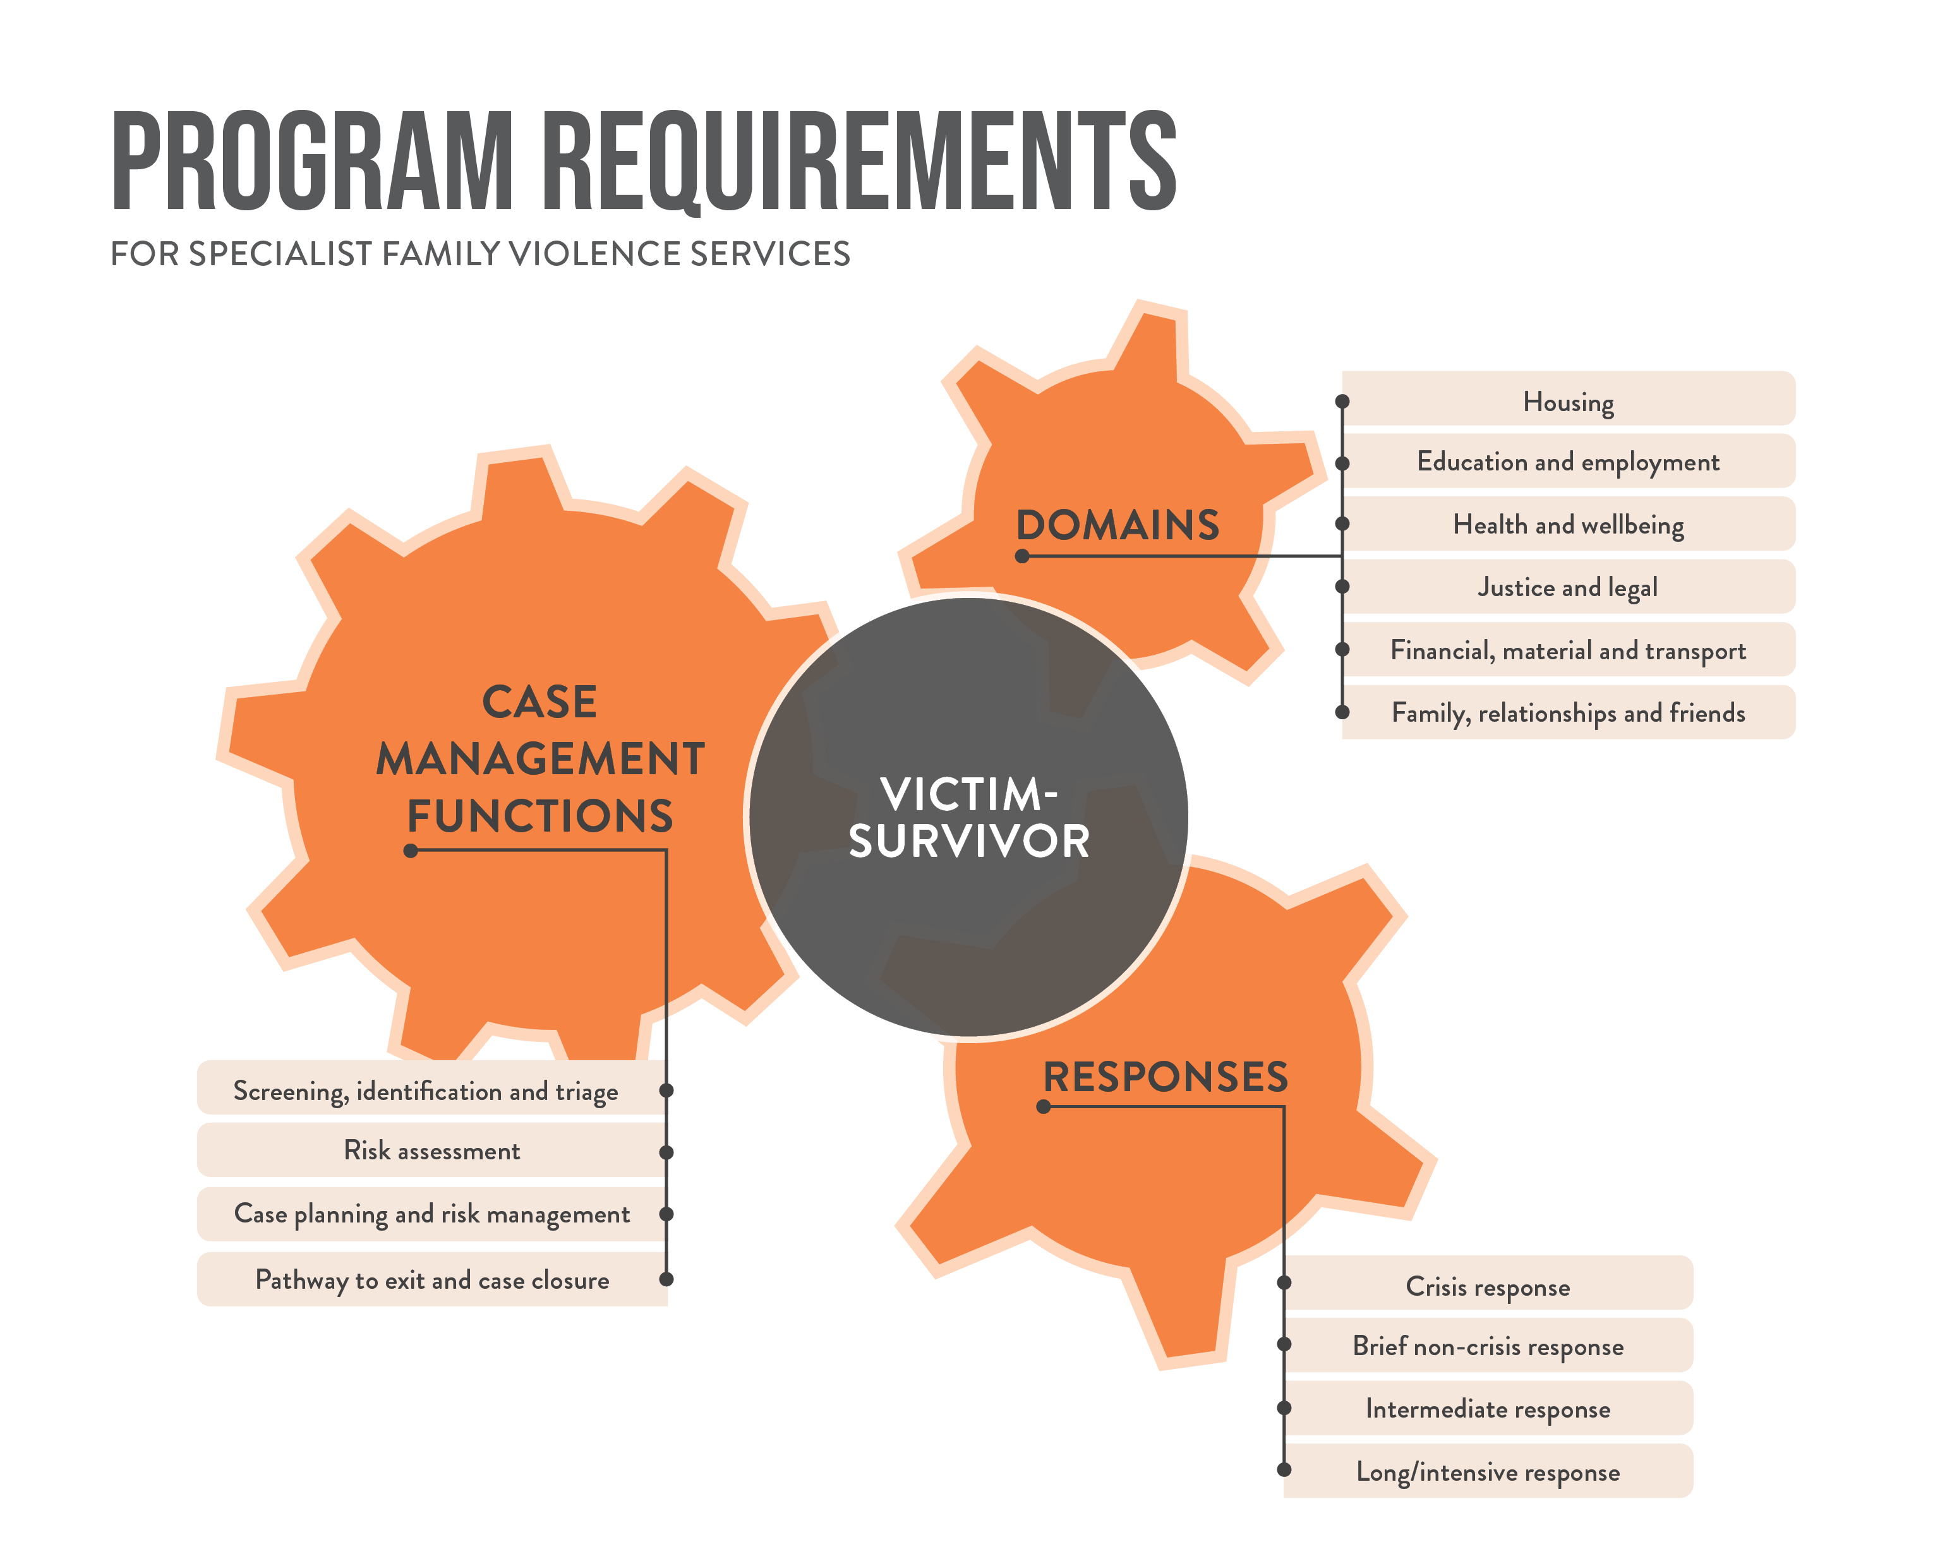
Program requirements - Structure
Areas of victim-survivors’ lives that are impacted by perpetrators’ violent behaviour. Protective factors.
Engaged by services to respond to victim-survivors from entry to exit in the service journey.
Duration and intensity of the support provided by services.
Case management activities are not linear or cyclical –
they respond to victim survivors’ risk, needs and circumstances.
Notes:
Pitched at the organisational level, the Case management program requirements are designed to be a comprehensive guide or case management ‘manual’ for service managers, describing the ‘what’ agencies need to do to ensure quality case management service delivery.
They are aligned with the Code of Practice (which describes the ‘why’) and MARAM Framework (which describes the ‘how’). All three share similar goals, which are to:
engage with evidence-based best practice
enhance quality service provision
enable state-wide consistency.
They have been structured around three core inter-related components that respond to victim survivors’ risk, needs and individual circumstances, taking into consideration the settings, situations, and impact of family violence on them.
Responses: Describe the duration and intensity of the case management support provided by services, which is often influenced by risk, complexity and a victim survivor’s readiness. It includes crisis responses as part of case management and recognises that “crisis” can occur at any time of victim survivors’ journey, even when a victim survivor is receiving a long-term response.
Functions: Describe case management activities which are engaged to support victim survivors from entry to exit in the service journey. These functions are key in helping to link Responses and Life Domains. They are not necessarily linear or cyclical because victim survivors’ risk, needs and circumstances can change at any time.
Life Domains: Describe victim survivors’ safety and support needs across their life domains with an intersectional lens, taking into consideration the impact of perpetrators’ violent behaviour and ongoing complexities and barriers they face when seeking help. Life Domains become needs that should be addressed in a coordinated way, but if they are not impacted, they may represent protective factors and strengths that could be maximised.
For victim survivors, they will deliver more consistent, equitable and accessible quality services across the state, no matter where they live or what support they need.
For Case management services, they provide a set of comprehensive, universal quality criteria which comprise value indicators at every stage of client support and links to essential tools and additional guidance.
For Government, sector partners and stakeholders, they synthesise the extensive reforms to the specialist family violence service system through quality performance indicators, incorporating legislative and policy changes and funding boosts which support victim survivors to recover and stay safe.

Slide 5
Relationship between CMPRs and Family violence crisis responses: Roles and responsibilities after-hours
Family violence crisis responses: Roles and responsibilities after-hours
articulates system level after-hours crisis responses
shows how each part of the family violence after-hours service system is expected to function and work together in the delivery of after-hours crisis responses.
Case management program requirements
covers each step in a victim survivor’s journey through the specialist family violence service system, from crisis to exit
includes more detailed material to support work with children and young people and specific program requirements for specialist family violence services.
after-hours responses will typically involve only a subset of the CMPRs to be applied

Slide 6
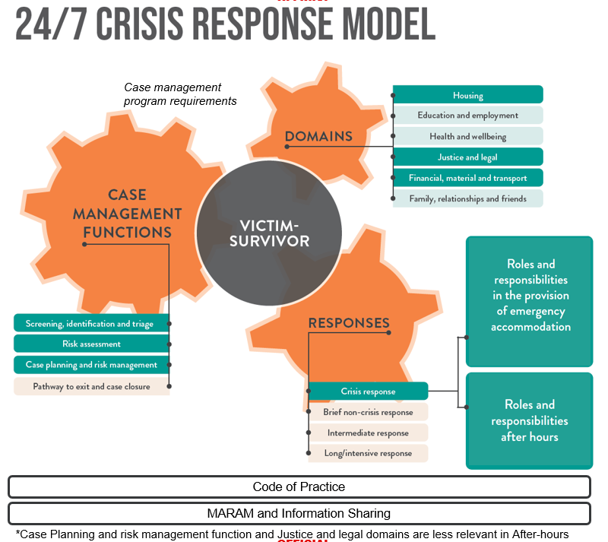
Notes:
For agencies that work with victim survivors in crisis, generally only a subset of the full Case management program requirements will apply in an after-hours context.
This diagram demonstrates how the Crisis Response Model relates to the Case Management Program Requirements and the relevant components. The responses, functions and domains highlighted here in dark green are those most relevant to a crisis response. The domains highlighted in lighter green are still relevant in a crisis response. All of the green elements, including both sets of roles and responsibilities, will constitute the Crisis Response Model.
Family violence services providing an after-hours crisis response should navigate to the Crisis Response section of the program requirements to consider and understand the relevant domains and functions and ensure that their service response is aligned.
*Talk through some scenarios which pertain specifically to after-hours’ providers system role in CRRRs emergency accomm and A-Hs*

Slide 7
After-hours services – your role
Summary of after-hours role
Provide local after-hours crisis support, including phone based and outreach support, when required.
Focused on support for victim survivors not in or able to access family violence accommodation services.
Placement into emergency accommodation (motel), when required.
Relationship with CMPR:
After-hours services must “Provide case management support, including crisis response (such as safety planning, emotional support, referral to other services and provision of material aid), as per Case Management Program Requirements.” (p.8)
CMPR provides quality indicators of good practice
Notes:
Examples of relevant CMPRs in after-hours context

Slide 8
Case management program requirements – implementation timeframes
By end June, self-assess the alignment of existing operations and procedural documentation with the program requirements using self-audit tool.
By the end of September, provide an Action plan to local APSS that, at a minimum, incorporates changes required to align their operations and procedural documentation with the program requirements.
By end December, finalise operations and procedural documentation updates and commence preliminary activities to embed the program requirements (for example, via awareness raising activities with internal teams.
In the first three months of 2023, review Action plans for completeness and update as required with further actions to fully embed the program requirements into organisational service delivery practices alongside work for MARAM and the Code of Practice .
Notes:
The key implementation steps and timeframes for in-scope agencies are:
By end of June 2022: Self-assess the alignment of service delivery practices against each of the program requirements, starting with a review of policy and procedural documentation. This can be done using the combined mapping document, self-audit tool and action plan distributed to agencies prior to each divisional information session in February / March 2022. Agencies are also welcome to use a self-assessment tool and action plan of their own design, or alternatively to use one of the two additional self-assessment template options developed by Safe and Equal in response to sector. The completed self-assessment should inform an action plan outlining the changes that will be made to align agencies’ policy and procedural documentation with the CMPR. Safe and Equal also developed an evidence guide to assist agencies with this process.
By end September 2022: Develop an agency action plan and provide to local APSS contacts (noting there is no formal ‘approval’ required for these – this is about ensuring agencies have one). Agency action plans can go further than this if they wish and start to identify some of the other changes that might support them to organisationally embed the CMPR into service delivery practices.
By end December 2022: Update internal policy and procedure documents based on agency action plans. Agencies will need to keep local APSS contacts updated on progress against their action plans.
Jan - March 2023: Review action plans for completeness and update as required with further activities to more fully embed the CMPR into organisational service delivery practices alongside work for MARAM and the Code of Practice.
Continue with work to implement the additional identified activities to more fully embed the CMPR into organisational service delivery practices – maturity approach as per MARAM.
Key points:
Alignment work is very much in keeping with related continuous quality improvement practices required for accreditation and contractual purposes.
Agencies can undertake the activities required to align their service delivery with the program requirements over time.

Slide 9
Case management program requirements – implementation support
Safe + Equal are leading implementation support activities. Current work includes:
Establishment of repurposed Implementation Champions Working Group, dedicated to implementation and embedding of the Program Requirements
Meeting with services 1:1 to provide implementation support
Tools to embed the Program Requirements into service delivery practices:
Self-assessment tools – CMPR and HSS
Implementation Evidence Guide
Tip Sheet for Implementation
Truncated summaries of each section of the Program Requirements (for discussion and dissemination at Working Group)
Developing a page on Safe + Equal website, including exploration of member only resources

Slide 10
Additional tools and resources - FSV
FSV is progressing work on additional resources to support agencies to implement the Case management program requirements.
This work largely sits within the Program and Service Development Unit and is supported through our implementation teamwork with Safe + Equal.
These are some examples of ‘enablers’ scheduled for development this year to support implementation of some of the crisis response elements within the Case management program requirements:
refuge eligibility and prioritisation (policy)
refuge referral pathways (policy and procedures)
a standard refuge referral / application (procedure/template)
Notes:
Some case management program requirements may need to be fleshed out in more detail through supplementary policy work.
By way of example, FSV is developing high level guidance for refuge eligibility, prioritisation and referral pathways and standard refuge referral / application form which will support Family violence accommodation services to deliver the Screening, identification and triage function. This piece will also support the roll out of the crisis responses work. Once complete, this work will become an additional resource under the Case management program requirements.

Slide 11
Got questions?
(03) 8346 5200
admin@safeandequal.org.au
Program Service Development
1300 758 554
Programservicedevelopment@familysafety.vic.gov.au

