Slide 1
Additional Data Extract – HDC reporting training session
Family violence funded agencies

Slide 2
Acknowledgement of Country
I would like to start with acknowledging the Traditional Custodians of the land I present from today, Ngunnawal people, and pay my respects to their ancestors and Elders past and present. I extend this acknowledgement and respect to all Aboriginal or Torres Strait Islander people here today.

Slide 3
Content
This training session will cover changes to the data reporting requirements for funded family violence agencies within Victoria for the five additional fields including:
Multi-Agency Risk Assessment and Management (MARAM)
Accommodation type
Family violence fund type (FVCB, FSP etc).
Service hours
Program related fields.
The session will also cover extracting and submitting the Additional data extract to HDC (for data custodians).

Slide 4
Overview and background of changes
The National Agreement on Social Housing and Homelessness (NASHH) requires funded service providers in Australia to make monthly client data submissions to the Australian Institute of Health and Welfare (AIHW) for the national minimum data set, by participating in the Specialist Homelessness Services Collection (SHSC). The family violence sector in Victoria receives funding under the NASHH and is required to provide the SHSC monthly data submissions under this agreement.
The AIHW provide access to funded services to the Specialist Homelessness Information Platform (SHIP) to comply with the SHSC data requirements. Victoria has gradually added fields to SHIP version used by Victorian agencies (Vic-SHIP) to capture additional data that enhances our understanding of case management and client outcomes providing more granular information in areas such as the type of support offered to clients.
To ensure the Department of Families Fairness and Housing (the department) has access to the additional data collected, an Additional Data Extract report that captures five data fields relating to the client’s accommodation type, program, funding type, service hours and MARAM risk assessments was implemented in 2024. Funded services were required to align themselves to the additional reporting requirements from 1 December 2024.

Slide 5
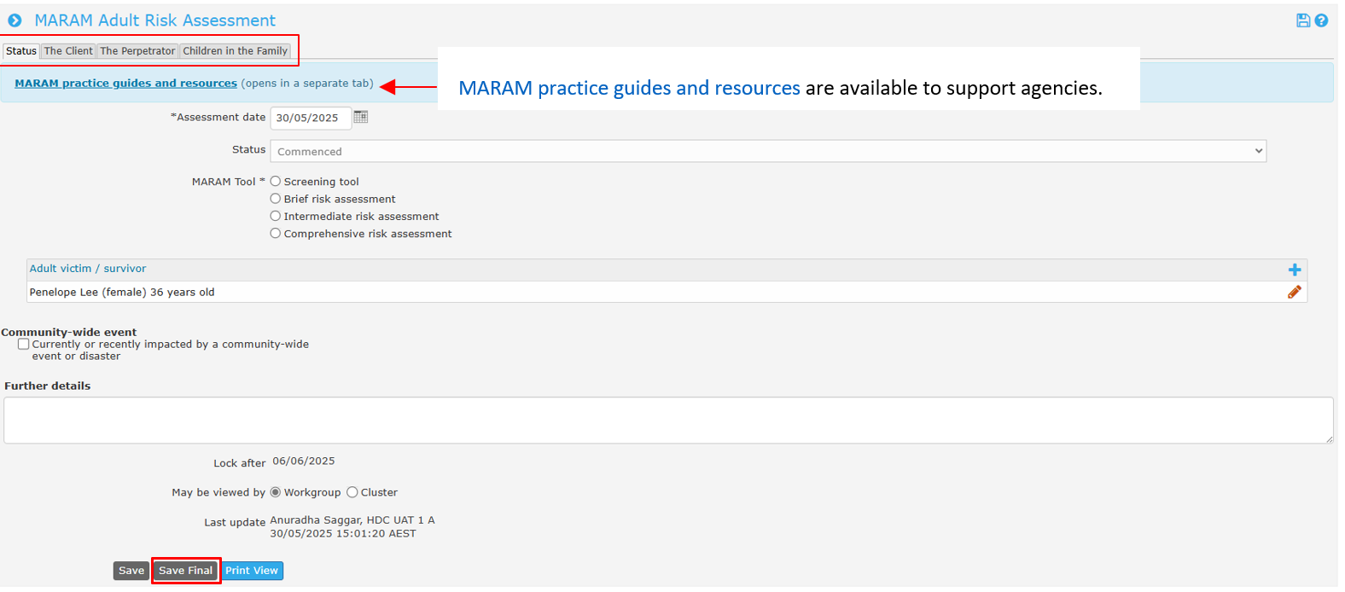
Multi-Agency Risk Assessment and Management (MARAM) framework
There is no change to how MARAM risk assessments are completed. Agencies provide information such as age range for a user of family violence, relationship type between a victim survivor and user of family violence, and risk level present for a victim survivor. When the MARAM risk assessment tool has been completed, the user must select Save Final.
MARAM practice guides and resources

Slide 6
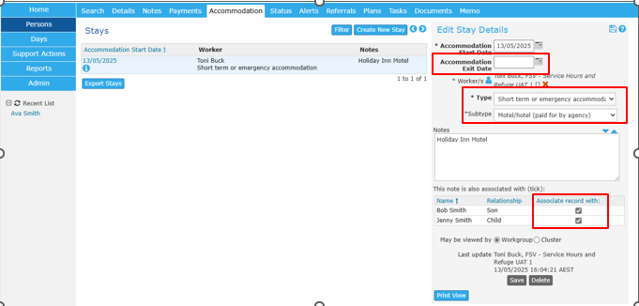
Accommodation type
Previously:
Agencies were required to record Accommodation Start Date, Exit Date and Type of accommodation provided.
Now:
Agencies are required to record Accommodation Start Date, Exit Date, Type of accommodation and Subtype. Agencies must record within notes, where the client is residing, for example: Holiday Inn Motel, Airbnb. Do NOT record the address of the short term/emergency accommodation.

Slide 7
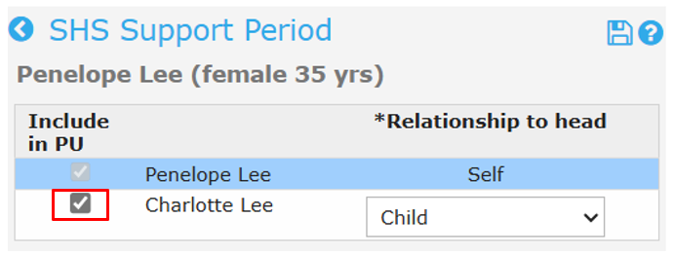
Support periods for members of a presenting unit
The Victorian Family Violence Data Collection Framework highlights the importance of identifying and recording children and young people as individual victim survivors, rather than as secondary to adult cases.
It is important to incorporate children’s voices in data collection and service responses to ensure their experiences are accurately captured and addressed.
If your agency is providing accommodation support to children, you must create individual client records for them to associate the accommodation record.
The process to open a support period for family members is demonstrated in the following e-learning module: Support periods for family members

Slide 8
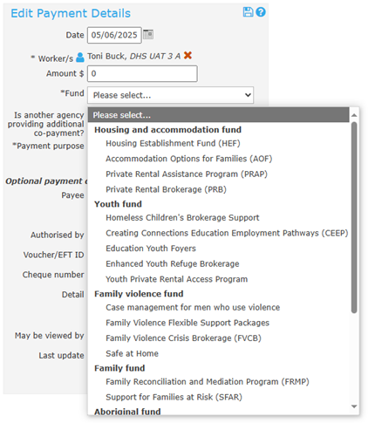
Family violence fund type (FVCB, FSP etc).
Previously:
Agencies were required to record expenditure incurred by the agency to support their clients.
Now:
Agencies must record the actual costs incurred when supporting a client—not estimates. For instance, if a client stays in a motel, record the exact amount charged by the motel, rather than estimating the cost based on a projected number of nights. It is essential to select the correct ‘Fund’ that was used to support the client, so that funding usage is accurately reported.

Slide 9
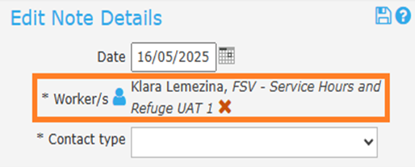
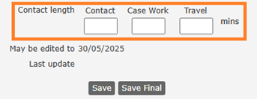
Service hours
Agencies must capture accurate hours of engagement with their clients to better track the intensity of case management, including direct and non-direct support.
This includes recording accurate travel, contact, and case work time.
Where a two worker outreach response has been provided the second worker should be added to the case note.

Slide 10
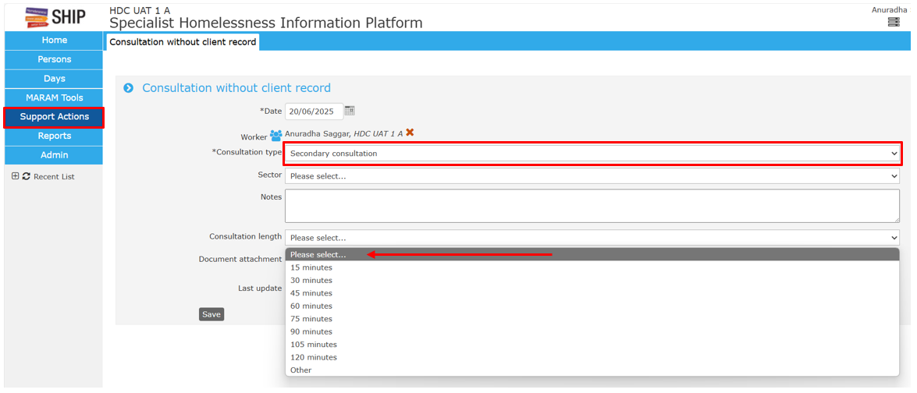
Support actions within SHIP
Support Actions is a repository for recording any information where there is no client record. This allows for the recording of time to a case note where no support period has been opened.
Secondary Consultations includes a consultation with a third party, or professional about a client where consent to obtain a client record is not provided.

Slide 11
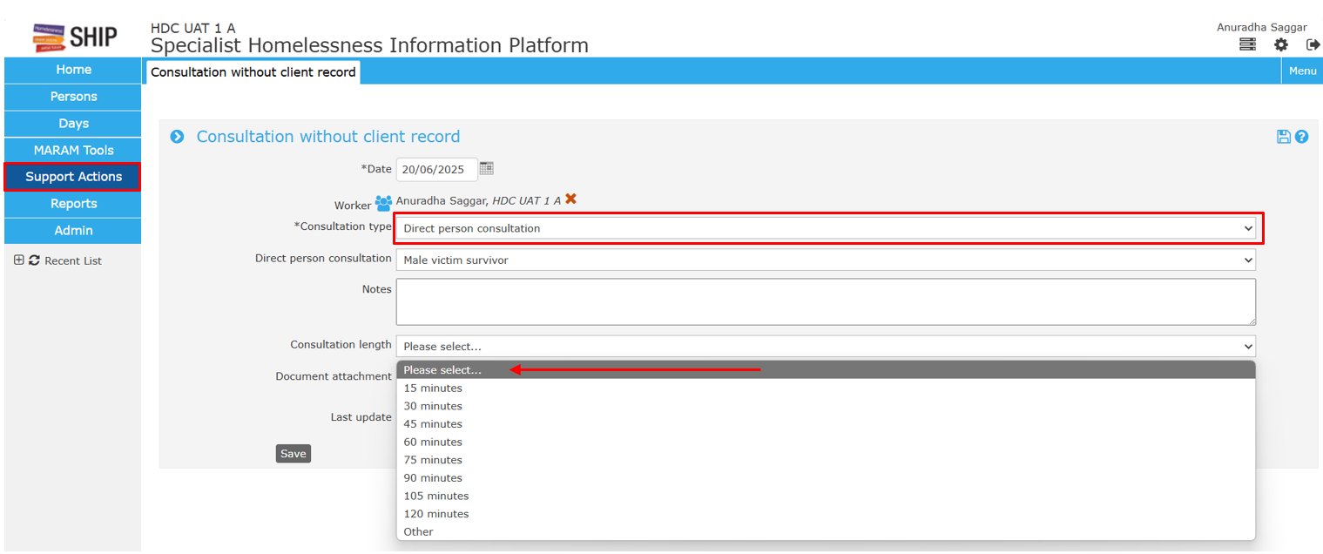
Support actions within SHIP
Direct person consultation includes a consultation with a client or group of clients, where consent to obtain the client(s) record is not provided. In these instances, record details about the consultation and the consultation length in this form.

Slide 12
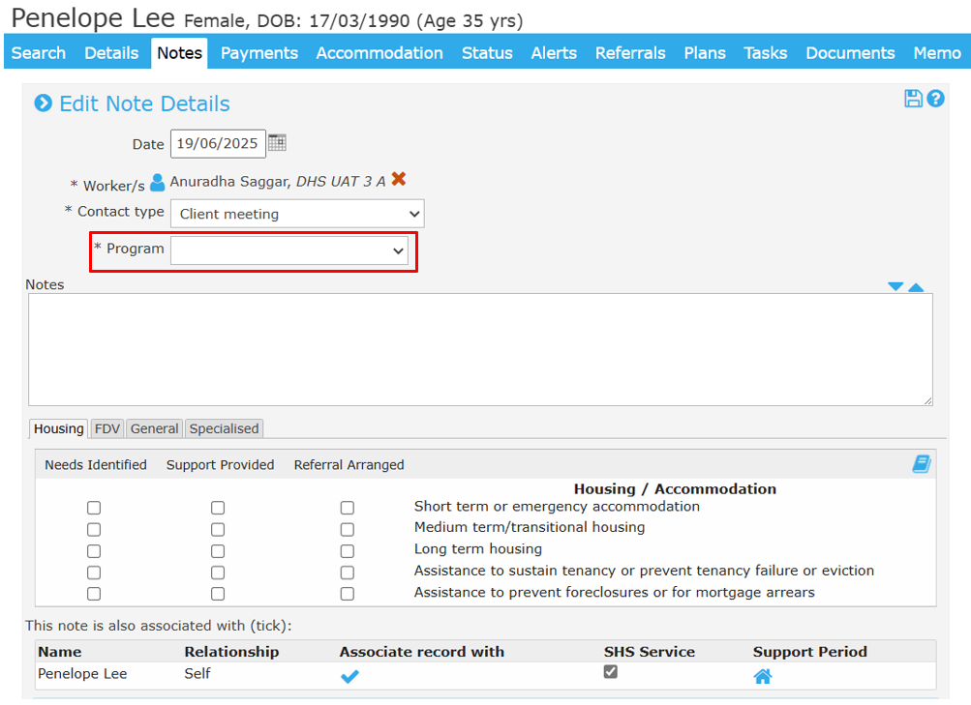
Program field
Programs enable agencies to create program subtypes within the one workgroup to track performance such as service hours or payments for separate programs of work such as Crisis Response or Case Management, when both responses are provided by the same workgroup.
You must select the respective program in the drop-down selection to be able to report accurately on each program.

Slide 13
Break time
Notes:
10-15mins break.
Image taken from: Apple MacBook beside computer mouse on table photo – Free Office Image on Unsplash

Slide 14
Case scenario
Angela, mother of 2 is a client of ACME Family and Community Services.
Angela is a victim of Family and Domestic violence.
She requires several services including:
Short-term accommodation stay for Angela and her children.
$200/- food vouchers.
Specialist Homelessness Information Platform

Slide 15
Accommodation
My agency supported Jennifer and her child with short term accommodation.
After creating a note within SHIP, I entered the information in the Accommodation tab.
Did I leave out any important or essential details?
Notes:
Option 1: I have not chosen the Accommodation sub-type.
Option 2: I have not chosen the Accommodation sub-type and associated the stay with Ali.
Option 3: I have not chosen the Accommodation sub-type, associated the stay with Ali and included an Accommodation end date.
Answer: Option 2
This is to ensure the participants are aware of the importance of selecting the Accommodation sub-type, associated the stay if there are more than 1 client accommodated by the agency.
Also highlight the importance of always including an accommodation end date.

Slide 16
Case Note
Penelope Lee called my agency to discuss mental health services available to her.
After speaking with Penelope over the phone, I arranged a referral for her.
I created a note in SHIP to record this interaction.
Did I leave out any important or essential details?
Notes:
Option 1: I have forgotten to select Program type.
Option 2: I have completed the note correctly.
Answer: Option 1
This is to ensure the participants are aware of the importance of selecting the respective program to ensure that the agency is capturing service hours related to each program they deliver.

Slide 17
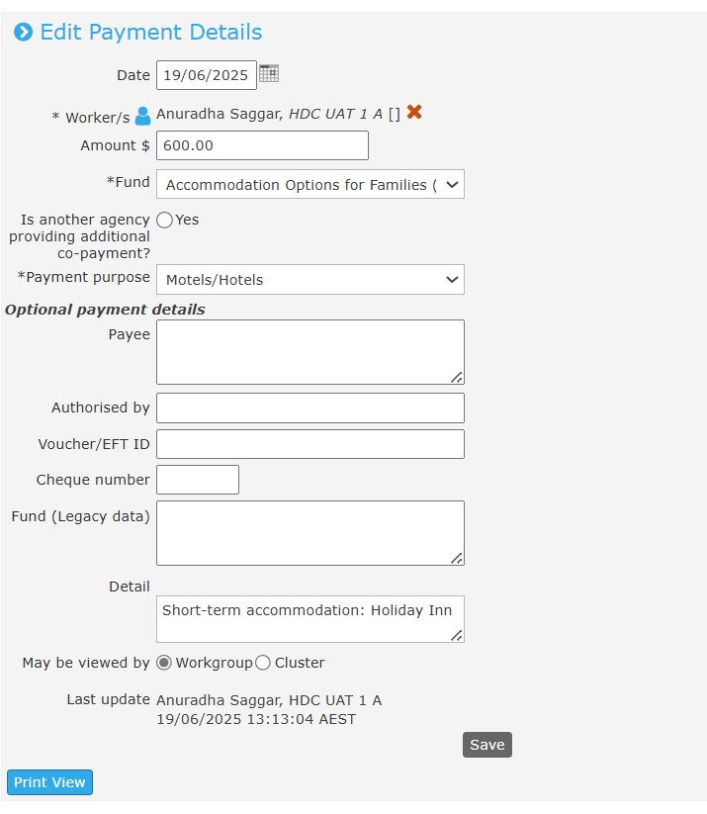
Payment
My agency is supporting Emma and her two children. Initially we provided them with short-term accommodation in a Holiday Inn motel for 3 nights at the cost of $200/per night.
This stay extended by a further 5 nights before Emma and her children entered a refuge.
I have approximated the cost for my agency to be $600 for 3 nights.
Is there any significant information I may have overlooked?
Notes:
Option 1: I should report the accurate cost incurred by my agency to support the client.
Option 2: I have completed the note correctly.
Answer: Option 1
Participants should ensure that they are aware that they must report on the actual cost incurred by the agency when supporting a client and recording the information in SHIP.
In the scenario as described above, the worker had recorded $600/- for the stay which was for 3 nights.
However, as it was extended for a further 5 nights, there was an additional $1000/- that the agency incurred to support the family. As the worker forgot to note this change in SHIP, it has resulted in an underreporting of $1000/- for the stay.
Users must remember to reflect changes in the Payments tab to ensure an accurate representation of the expenses incurred by the agency.

Slide 18
Questions

Slide 19
Further support
Need help using SHIP or Validata™?
For help with SHIP, email apps@infoxchange.org or phone SHIP support on 1800 627 191 (option 1).
For help with the HDC Secure Data Exchange including access, please email your request to the HDC Support Team HDC@support.vic.gov.au
For help with Validata™ to upload extracts or resolve critical errors, email homelessness@aihw.gov.au or phone the AIHW SHS Hotline on 1800 627 191 (option 2).

Slide 20
Data custodians' session commencing shortly
Notes:
Script (if applicable):
As we have travelled well for time, we will be taking a short break and will recommence at 11:45am
Duration of break depends on how the session is traveling (e.g.: 5-15mins)
Image taken from: How Effective Breaks at Work Increase Productivity | Work-Fit Blog

Slide 21
Data custodians - Extracting and submitting the Additional HDC data file
Previously:
Agencies were required to generate one SHS file and submit it to Validata™ and to the HDC to comply with funding requirements.
Now:
Agencies continue to submit the SHS file by uploading it to Validata™, for example: shs_extract_12345A_2025_07.xml
Agencies are required to submit the SHS file and a new additional HDC data file to HDC, for example: HDC_extract_12345A_2025_07.xml
In total data custodians will need to generate two files each month per workgroup.
Notes:
Script:
Welcome Data custodians to the Additional Data Extract HDC reporting training session catered to Family Violence funded agencies.
My name is Anuradha and I am the SHSC Training Manager from the AIHW and I will be your facilitator for today’s training session.
We also have Toni and Betty from FSV joining in our session today and will be monitoring the chat box too.
I will now discuss the process of Extracting and submitting the Additional HDC data file.
Previously:
Agencies were required to generate one SHS file and submit it to Validata™ and to the Homelessness Data Collection (HDC) to comply with funding requirements.
Now:
Agencies continue to submit the original SHS file by uploading it to Validata™ (point to screen)
Agencies are required to submit the original SHS file and a new additional HDC data file to HDC (point to screen) via Secure Data Exchange platform.
In total data custodians will need to generate two files each month per workgroup.

Slide 22
Process of extracting and Submitting the additional HDC data file
Once the data file has been exported from SHIP, data custodians must submit it via: Secure Data Exchange
DO NOT rename files as this causes confusion and difficulty in file analysis by the HDC Support Team. The original file name will have all the required identification details.
Notes:
Script:
The HDC extract file is exported from SHIP through the Reports page and its corresponding Reports tab. (point to screen)
Once the data file has been exported from SHIP, data custodians must submit it via: Secure Data Exchange
DO NOT rename files as this causes confusion and difficulty in file analysis by the HDC Support Team. The original file name will have all the required identification details.
Where an agency has not had access to the SDE or has had a change in staff they should complete the SDE3 User Registration Form. You will need to know your Agency SAMS ID to complete the form.
Where access to the SDE is pending or errors are reported when submitting the extract, the agency can email the HDC Support Team HDC@support.vic.gov.au with the data file.
The due date for submission of the SHS and HDC extracts is 10 business days following the end of each month. A list of due dates for 2025 is available in the Additional Data Extract – How to guide.
You will receive an email receipt from both Validata™ and the HDC for every file submission. The subject line will identify the file type and workgroup for the file. Please check your email receipts each month to ensure your data has been received both by Validata™ and the HDC.
SAMS ID= Secure Agreement Management System (SAMS).

Slide 23
Question time
Notes:
5mins
Are there any questions relating to any of the material that has been presented?

Slide 24
Further support
Need help using SHIP or Validata™?
For help with SHIP, email apps@infoxchange.org or phone SHIP support on 1800 627 191 (option 1).
For help with the HDC Secure Data Exchange including access, please email your request to the HDC Support Team HDC@support.vic.gov.au
For help with Validata™ to upload extracts or resolve critical errors, email homelessness@aihw.gov.au or phone the AIHW SHS Hotline on 1800 627 191 (option 2).
Notes:
Thank you for attending today’s webinar training session.

Slide 25
Additional HDC Data Extract – training slides
To receive this document in another format, phone 03 9085 0900, using the National Relay Service 13 36 77 if required, or email Family Safety Victoria <reception@familysafety.vic.gov.au>.
Authorised and published by the Victorian Government, 1 Treasury Place, Melbourne.
© State of Victoria, Australia, Family Safety Victoria, July 2025.
Available at https://providers.dffh.vic.gov.au/additional-hdc-data-extract-training-slides <https://providers.dffh.vic.gov.au/additional-hdc-data-extract-training-slides>

